Slide 1
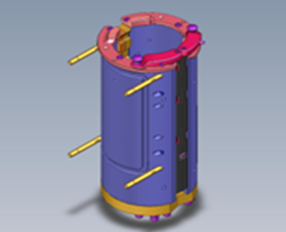
Significant decrease in changeover times
Bottle Switch™ Universal – Pack 2
VALUE AND BENEFITS
DESCRIPTION
Efficiency: 50% less production downtime with only one operator
Cost optimisation: Less downtime means better TCO
Safety: Semi-automated system with fewer manual operations
Simplicity and ergonomics: Tool-free operations and easy access to parts
Sidel's patented Bottle Switch™ improves blow-moulder flexibility by reducing the mould changeover time to less than a minute, cutting downtime in half. This semi-automatic solution is easy for operators and requires no tools.
The Bottle Switch™ is declined in 5 packs to match to customer needs.
This Pack 2 contains mould body changeover
Changeover time | Without Bottle Switch | With Pack 2 Bottle Switch
Time needed per station (sec) | 221 | 123
Time needed per station (min and sec) | 3 min 41 sec | 2 min 03 sec
Example for a SBO 20 (min and sec) | 73 min 40 sec | 41 min
Gain in min vs standard |  | 32 min 40 sec
People needed | 2 | 1
Value: Flexibility
Equipment: Universal blowers (MM GM TM), for the HR machines, RFQ mandatory
Catalogue code: 1003P2

