Slide 1
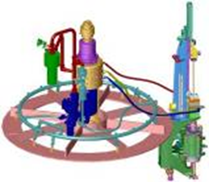
Recover up to 40% of blowing air
ARK: Air Recovery Kit
VALUE AND BENEFITS |  | DESCRIPTION
Up to 40% of blowing air is recovered and reused Return on investment in just 12-24 months Demand on compressors is also reduced resulting in significant electricity savings |  | The air recovery kit enables a significant amount of the air otherwise lost to be recycled for use in production and thus reduce energy consumption considerably This recovered air is then used for the production of air as follows Preblow air Service air for the blow wheel (stretching and nozzle cylinders) Excess air can also feed the factory's air network for other applications For hygiene reasons, the air recovery option is not compatible with Predis equipment.
DESCRIPTION
Value: Cost Optimisation, Sustainability
Equipment: Universal blowers
Catalogue code: 1005

