Slide 1
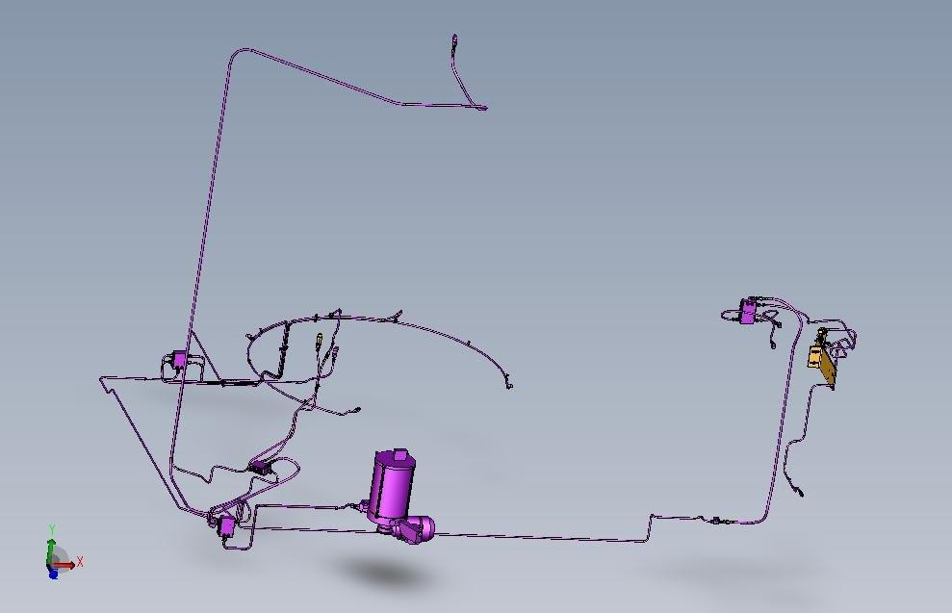
Eliminate costly downtime for lubrication and preserve equipment efficiency
Central automatic lubrication system
VALUE AND BENEFITS
DESCRIPTION
Reduced maintenance
Remove risk associated with build-up of grease on moving parts
Preserve equipment efficiency
The automatic lubrication system eliminates the risk of moving parts on the blower which have not been lubricated, thus fully complying with Sidel best-practice operation guidelines
The system is managed by the machine PLC which lubricates various points on the machine at preset intervals on the basis of machine rotation time
Manual lubrication can be performed in the event of a PLC fault
Value: Efficiency
Equipment: Blower Universal
Catalogue code: 1011

