Slide 1
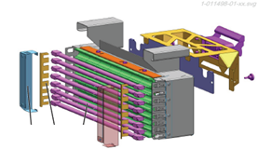
ECOVEN
Sustainability
Ref. 1021 - 20% to 45% less electrical consumption
KEY FIGURES
Budget price:
BENEFITS
DESCRIPTION
50k €*
New adjustment block/oven support: Independent setting of neck cooling shield for more stability.
Ecoven module for lamps cooling: The Super Cobra is replaced by a fan dedicated to each module.
Heating modules: Only 8 IR lamps, more efficient lamps, ceramic wall and top reflector.
Ceramic oven top reflector, adjustable in height to fit all preform lengths.
Wiring: Pre-wired cabinet added to supply power to the fans.
New automation and process: Updated main electrical cabinet (power supply, new functionalities and readjustment of all process sheets).
20% to 45% less electrical consumption.
Fewer lamps for 11% less installed power.
Sharper heating: Sharp zoning on preform surface and optimized under-neck stretching.
Easier to maintain: Heating module can be serviced on the bench while the machine runs with a spare module.
Ceramics are self-cleaning via pyrolysis effect.
Payback estimation:
TBD
Installation time:
18 to 22 MenDays
Machine downtime:
TBD
*according to blower size and scope, installation not included.
Can be combined with:
TBD
Machine application:
All Universal except Predis C3 & C5.

