Slide 1



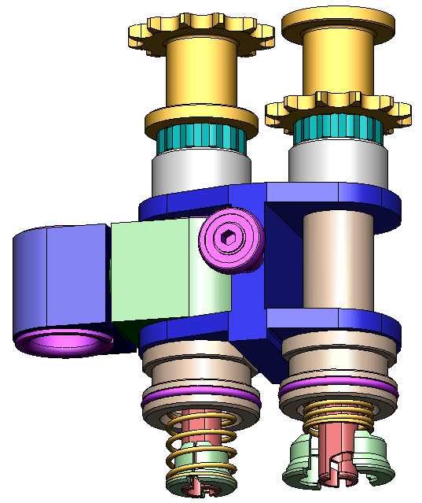
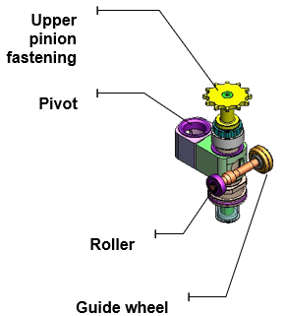
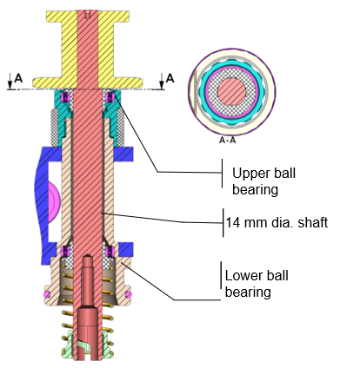
Reduce maintenance expenses on the spindle chain
COST OPTIMISATION
KEY FIGURES
Ref. 1022 - BEARING SPINDLE CHAIN
Budget price:
BENEFITS
DESCRIPTION
68k € up to 171k €*
Spindle Chain life span extended to 24,000 h. (before 12,000 h)
Less maintenance cost
Equipment availability increased
Preform neck protection from IR thanks to better alignment of S.C. with Cooling shields.
V bearing and Hepco guide ➔ better S.C. alignment
H made of aluminium / Links in stainless steel
Shaft & Spring enlarged diameter Pinion Hardness treatment ➔ Robustness
Change of Oven wheels, slides & guiding rails
Payback estimation:
2 years
Installation time:
14 - 17 Men*Days
 | Maintenance operation
 | Standard spindle chain | Full bearing spindle chain
6,000 h. | Refurbishment | No maintenance
12,000 h. | Replacement | No maintenance
18,000 h. | Refurbishment | No maintenance
24,000 h. | Replacement | Replacement
Machine downtime:
5 to 7 days
*This price depends on the number of oven modules and does not include installation.
Can be combined with:
Ecoven #1021
Gaz shocks on Ecoven #1027
Machine application:
Universal PM – MM – GM - TM

