Slide 1
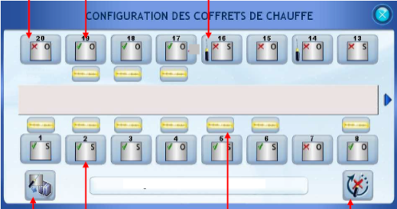
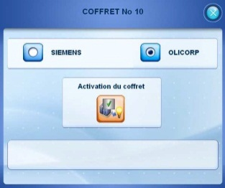
PCC VERSION V3.09
EFFICIENCY
Réf. 1024
KEY FIGURES
Budget price:
BENEFITS
DESCRIPTION
10K €*
Continuation of production despite the failure of one of the heating boxes.
Configuration, activation and deactivation of each heating box independently in a new screen page.
Because cyber security is a must for industrial control systems, you can move to the W10 HMI version!
Ask more about our product
1051_HMI migration to Windows 10
In the event of an equipment failure, there are two options to maintain your production:
Either deactivation of the non-functional box with a corresponding adjustment of the heating profile to offset the loss of heating capacity.
Or replacement of the box with an equivalent: an Olicorps box can thus be replaced with a Siemens box without the need for any change in automated procedures.
Comment: box selection is possible only if the box is activated and if no lamp is being used on the oven concerned.
Payback estimation:
TBD
Installation time:
2 MenDays
Machine downtime:
1 Day
*These data are approximate and not definitive, depending on your machine configuration.
Can be combined with:
N.A
Machine application:
Blowers Universal

