Slide 1
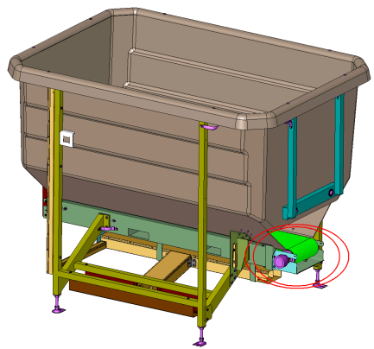
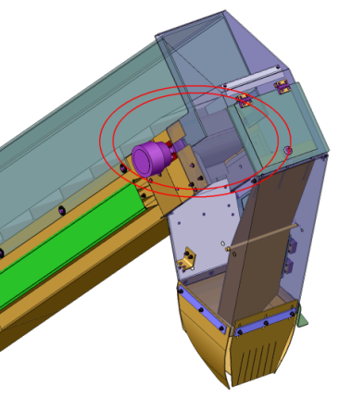
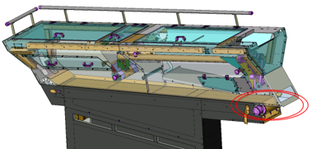
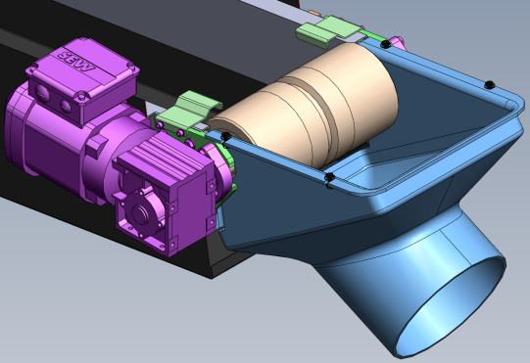
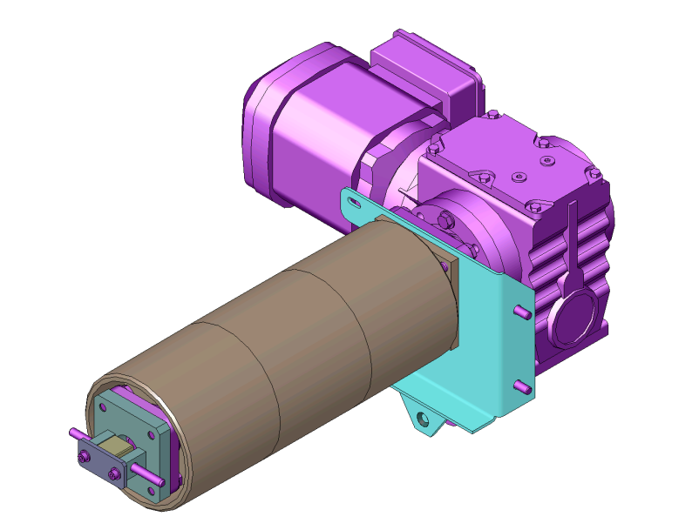
NEW MOTORS ON THE PREFORM FEEDER
Ref. 1026
Obsolescence
KEY FIGURES
Budget price:
BENEFITS
DESCRIPTION
18 k€*
Drum motors driving preform transportation belts on the hopper, the elevating column, and the recycling belt of orientation rollers are now discontinued, so not available in Spare Parts catalogue.
Anticipating replacement of such critical components will
Prevent from Spare Parts unavailability.
Prevent from risk of long downtime in case of failure.
Replacement of the 3 original drum motors by geared motoreducers. See pictures A – B – C
Example of possible kit : (could be different upon with equipment configuration)
Elevating column common kit
Cleated belt kit
Plug DP9 + wires
Eprom
Hard disk
Payback estimation:
Preventive Maintenance
No R.O.I.
Installation time:
8 MenDays*
Machine downtime:
4 days*
Lead Time:
A
TBD
*complete set for Preform feeder, not included installation.
Can be combined with:
HMI migration Windows 10 - #1051
Protective UPS - #1018
Remote Access Kit - #DIG020
Remote Video Assistance Kit - #DIG021
B
Machine application:
C
Blowing Universal

