Slide 1
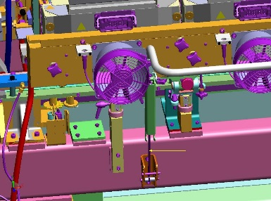
Increase operator safety
Gaz shocks on Ecoven
VALUE AND BENEFITS
DESCRIPTION
Damping of the downward movement during opening of the oven racks.
When closing the racks, the gas shocks assist the operator in his movement, reducing the needed effort.
Depending on the size of the oven, one or more gaz shock can be placed under each rack. These cylinders are calibrated according to the force to be produced, they are attached at the bottom, to the oven frame.
A locking latch system keeps the racks in the down position. Indeed, without this lock, whenever a heating module is extracted, the rack would tend to rise under the thrust of the cylinders.
Applicable only on ECOVEN
Value: Safety & ergonomy
Equipment: Universal with ECOVEN
Catalogue code: 1027

