Slide 1
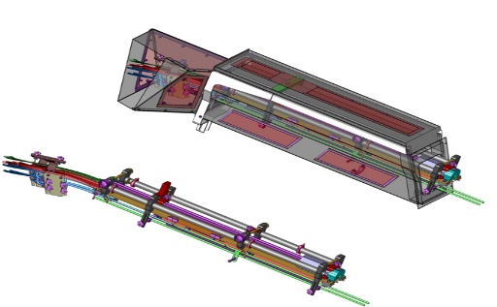
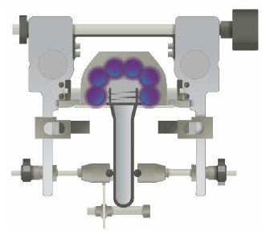
Increase hygiene level
UV Rail on preform infeed
VALUE AND BENEFITS
DESCRIPTION
Operating principle
Decontamination of the preforms external side and of the necks by UV (6-12 lamps with UV filter glass). The preforms are exposed to shortwave radiation when they pass through the infeed rail.
Main benefits
Decontamination of the preform necks.
Germicidal action on bacteria.
Replacement of the standard rail by a rail UV
This option can have an impact on machine footprint.
The final design of the solution is linked to the customer layout validation
Anti-UV cowling
UV lamps
Value: Product Quality
Equipment: Universal blowers
Catalogue code: 1049

