Slide 1
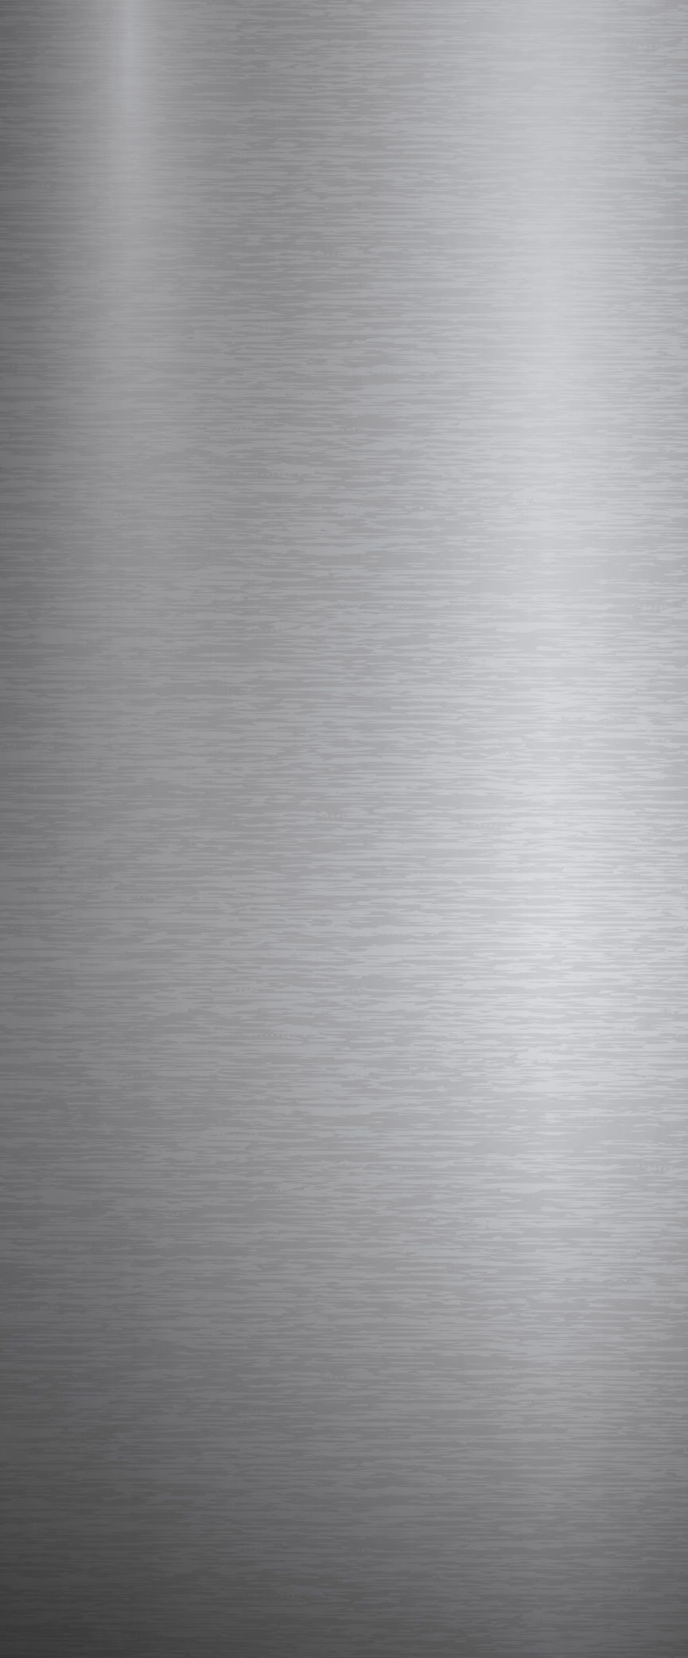


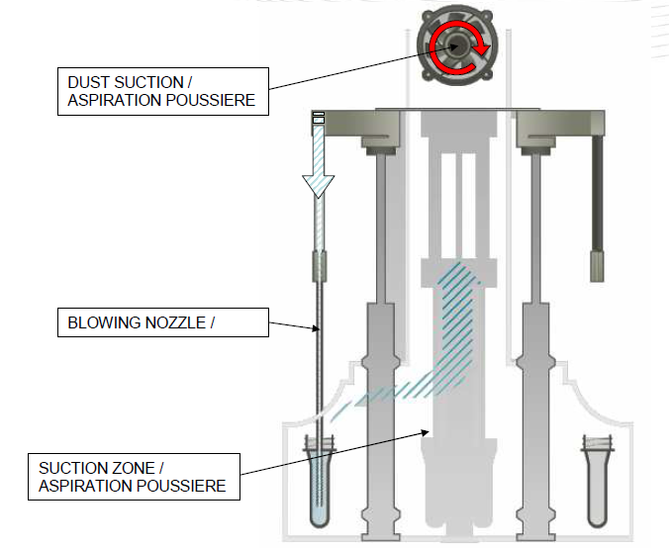
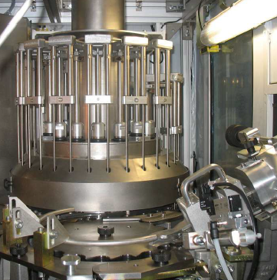
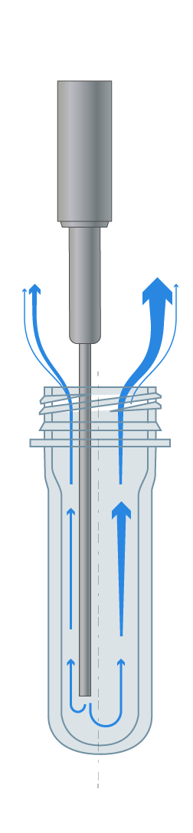
PREFORM DE-DUSTING MODULE
PRODUCT QUALITY
Ref. 1050
KEY FIGURES
Budget price:
BENEFITS
DESCRITPION
160 k€ *
Dust and Particles (PET, plastic, wood, carton, …) which may accumulate inside the preforms are removed out by a filtered air flow, blown through injection nozzles.
PET dust removed up to 100% (mini 97%).
Contributes to filled Product Quality, specifically in Blowing-Filling-Capping COMBI configuration.
Complete module for preforms internal walls dedusting with:
a rotary carrousel of cleaning air injection nozzles located between the oven infeed wheel and the preform infeed rail.
blown air filtration 0.01 µm and exhaust flow manifold with filters.
transfer wheel and related transmission to convey preforms up to oven loading.
oven housing extension to integrate the module.
Payback estimation:
Product Quality
Installation time:
18 men*days
Machine downtime:
6-8 working days
* MM size, installation not included.
Can be combined with:
Ionised Air System on Preform rail - #2082
Rocking Hopper cover - #1016
Deflector inside Preform hopper #2067
Machine application:
Universal
All size of blower
Matrix with #2011
Blower S2 with #506

