Slide 1
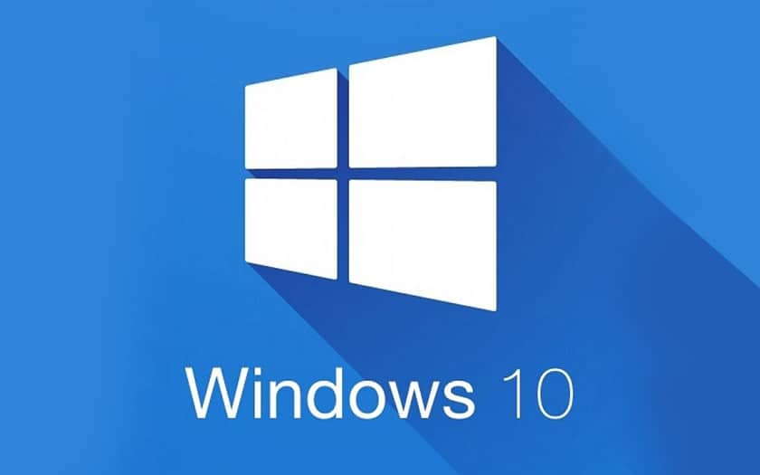
安全操作设备
HMI迁移到Windows 10
价值和益处
描述
In order to reduce the damages and harms caused by human error, cyber security is a must for industrial control systems.
Enterprise best practices for defense include basic but extremely important countermeasures like patching systems
Upgrading your HMI to Windows 10 is your best bet to stay safe from the ever-evolving threats from viruses.
The main advantages of Windows 10
System updates for a longer period
Windows 10 forces automatic updates
Excellent virus protection
Full control over Windows 10
Lighter and faster operating system
It’s time to upgrade to Windows 10!
Depending on your current configuration, the proposed kit to migrate your HMI to W10 can include :
New PCC (Delta V3 or V4-10/CIT)
New HD
New Eprom
Security controls (patching and hardening) up to date.
价值： 效率，灵活性
设备：Universal 吹瓶机
产品目录代码：1051

