Slide 1



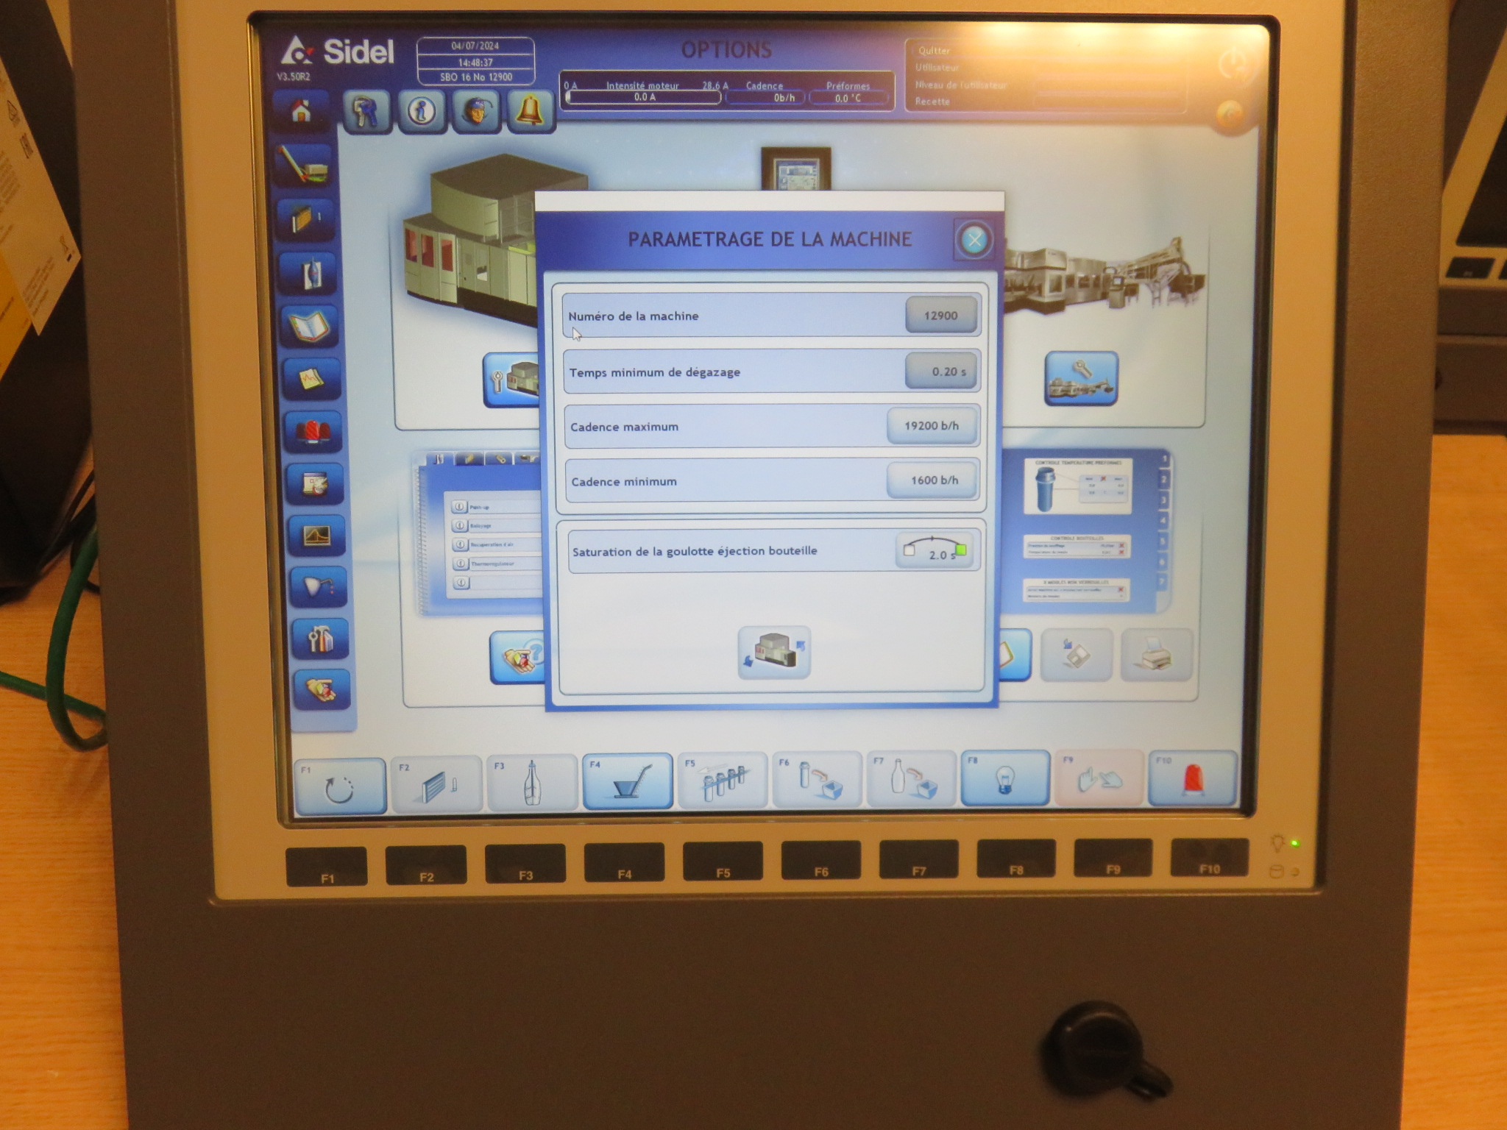

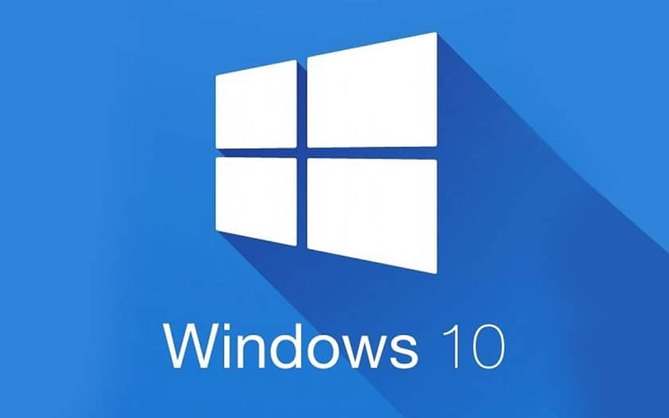
OPERATE YOUR BUSINESS SAFELY
SAFETY & ERGONOMY
Ref. 1051 - HMI migration to Windows 10
KEY FIGURES
Budget price:
BENEFITS
DESCRIPTION
23-29k€**
Upgrading your HMI to Windows 10 is your best bet to stay safe from the ever-evolving threats from viruses.
System updates for a longer period
W10 force automatic updates
Excellent virus protection
Lighter and faster operating system
Defense countermeasures and patching systems
Cyber Security & industrial control systems.
Reduce damages and harms caused by human error / external devices connection
It’s time to upgrade to Windows10
Depending on your current configuration, the proposed kit to migrate your HMI to W10 include:
New HD
New Eprom
Security controls (patching and hardening) up to date.
eventually New PCC
(Delta V3 or V4-10/CIT)
Payback estimation:
Not applicable.
Installation time:
3 MenDays.*
Machine downtime:
6 to 8 days.*
*according to blower size and scope.
** Installation not included.
Can be combined with:
Cloud Connectivity #DIG009
Machine application:
Universal

