Slide 1
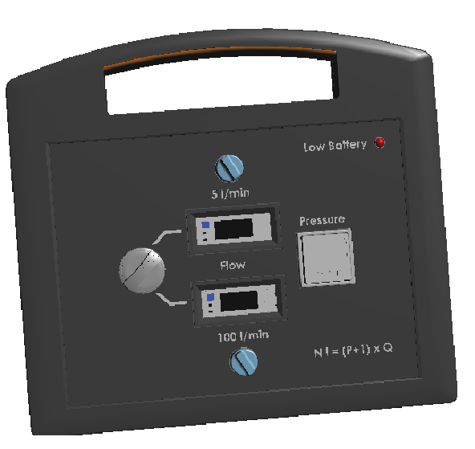
Secure your 7b air consumption
Air leaks detection
VALUE AND BENEFITS
DESCRIPTION
  Allow to define the energy losses on the blower 7b circuit
  Easy to use without any intrusive intervention
One carrying case incorporating the connection, fittings, hoses, and instructions for use in several languages
A double-gauge leakage measuring unit 10/100 liters, including a measurement of the corresponding pressure
Includes a rechargeable battery that facilitates the measurement process
Value: Efficiency, Cost optimisation
Equipment: Blowers Universal
Catalogue code: 1109

