Slide 1
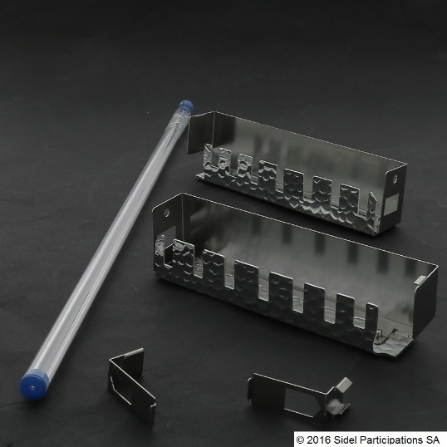
Improve bottle process flexibility
Quartz bars
VALUE AND BENEFITS
DESCRIPTION
Contribute to solve heating problems, especially on the preform under neck area.
Only for the first zone.
Recommended to secure rPET bottle production for:
a. neck protection
b. process robustness
c. ensure optimal material distribution
Installation of a quartz bar between the heating lamp and the preform, in order to concentrate / focus the IR radiation.
Value: Product quality
Equipment: Blowers S1
Catalogue code: 115

