Slide 1
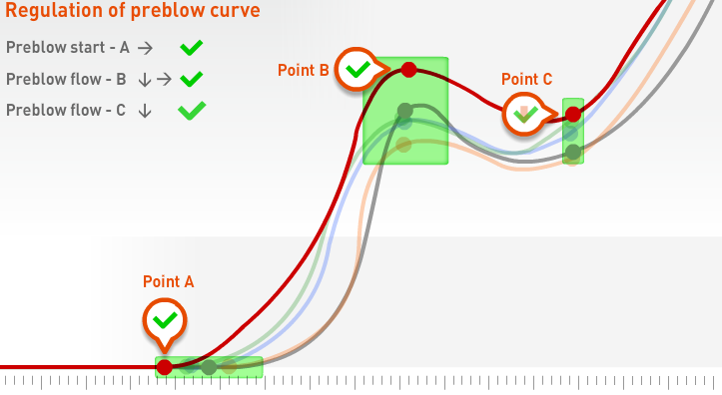
Secure bottle quality and weight
IntelliblowerTM
VALUE AND BENEFITS
DESCRIPTION
  IntelliblowerTM option ensures optimum accuracy of the blowing process for each bottle by:
    The automatic regulation of the overall preblow pressure
    The automatic regulation of the start of preblowing phase per station
    The automatic regulation of the preblow flowrate per station
  Reduce the variation of the bottle weight per zone
  Pack elements:
    Stepping motors to drive preblow flowrate limiters
    Power and regulation cables.
    Input/output modules
    PLC program.
Value: Product quality
Equipment: blowers Matrix
Catalogue code: 2001

