Slide 1
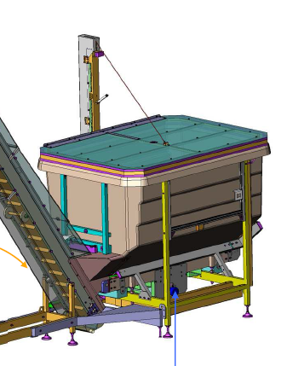
Increase product quality by limiting the preforms pollution in the hopper
Rocking hopper cover without overpressure
VALUE AND BENEFITS
DESCRIPTION
Better hygiene production by limiting the preforms pollution in the hopper
Avoid that a preform (collected from the ground, for example) or anything else, from outside the feeding area of the preforms is inadvertently or intentionally thrown into the hopper during the production phase
This option is to cover the upper part of the hopper to prevent the deposition of dust inside
It consists of a cover and a gear motor
In manual mode, during the loading of the preforms, the operator controls the opening / closing of the hood by means of a control unit.
Value: Product quality
Equipment: blowers Matrix
Catalogue code: 2008

