Slide 1
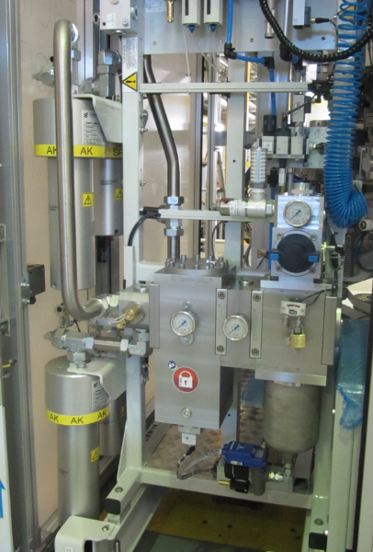
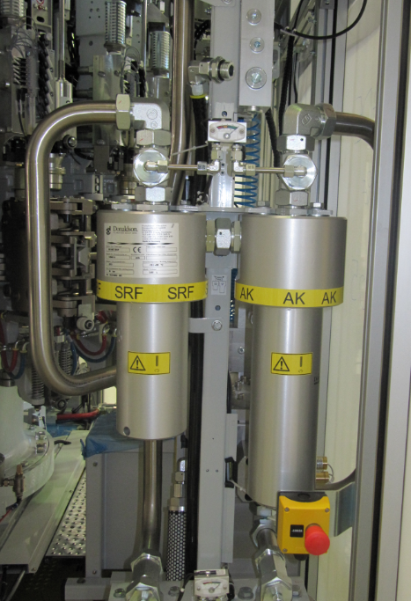
Secure product quality
40 B air super filtration
VALUE AND BENEFITS
DESCRIPTION
The unit of 2 filtering elements is fitted on the high pressure air circuit (40 bar)
It filters off oil vapors, gaseous hydrocarbons (charcoal filter) and micro-organisms (bacteriological filter)
The option consists of a set of high efficiency filters that prevent the passage of odors and dust in the air blowing
A charcoal filter "AK" eliminates odors and possible hydrocarbon vapors.
A bacteriological filter "SRF" eliminates the microorganisms.
Value: Product quality
Equipment: blowers Matrix
Catalogue code: 2009

