Slide 1
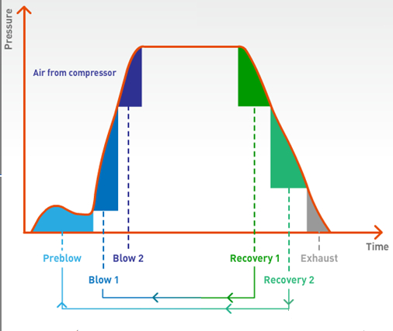
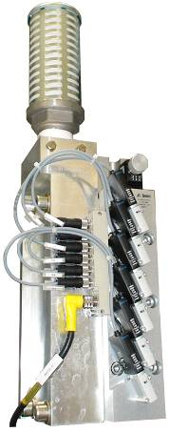
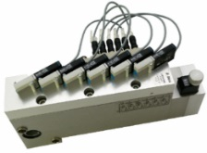
Reduce blowing air consumption and keep safe the final product
AirEco2 system
VALUE AND BENEFITS
DESCRIPTION
Increase component life time due to air filtration
Filtration on air reused for pre-blow and blowing increasing hygiene level on final product
Two valves are adding per station to allow a second step of recycling / blowing.
Value: Cost optimisation, Product quality, Sustainability
Equipment: blowers Matrix
Catalogue code: 2015

