Slide 1
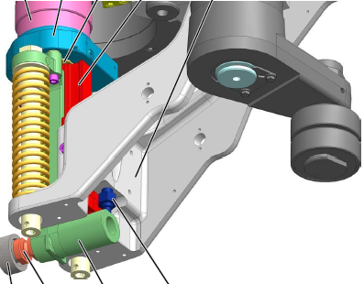
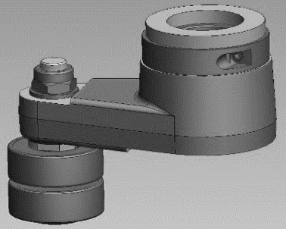
Less downtime and improved productivity
Mould O/C lever with hydraulic clamp
VALUE AND BENEFITS
DESCRIPTION
Quick and easy installation
Adjustment with a single screw, thus reduction of machine downtime
Improves the lifetime of the mold open/close cam.
Over 1,000 possible readjustments
An ETP-EXPRESS single-screw hydraulic tightening element is integrated into the mold open/close lever.
It replaces the original RLK cone clamping system
FAST SETTING SYSTEM WITH ONLY ONE SCREW
Value: Efficiency, Maintenance
Equipment: blowers Matrix
Catalogue code: 2023

