Slide 1
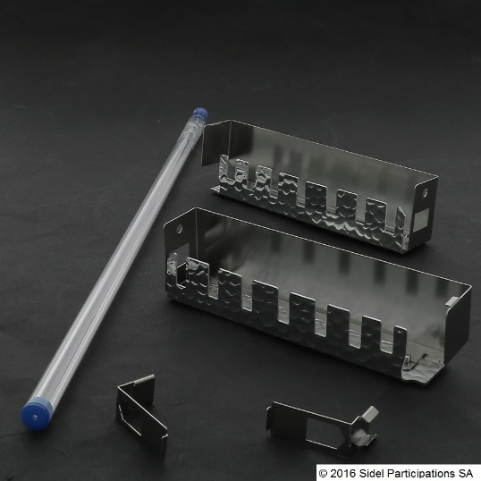
提高制瓶工艺的灵活性
石英棒
价值和益处
描述
Contribute to solve heating problems, especially on the preform under neck area.
Only for the first zone.
Recommended to secure rPET bottle production for:
a. neck protection
b. process robustness
c. ensure optimal material distribution
Installation of a quartz bar between the heating lamp and the preform, in order to concentrate / focus the IR radiation.
价值： 产品品质
设备：MATRIX吹瓶机
产品目录代码：2032

