Slide 1



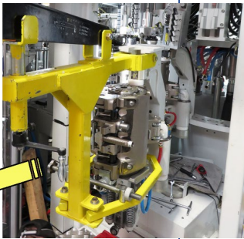
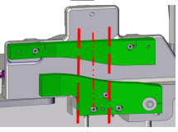
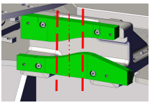
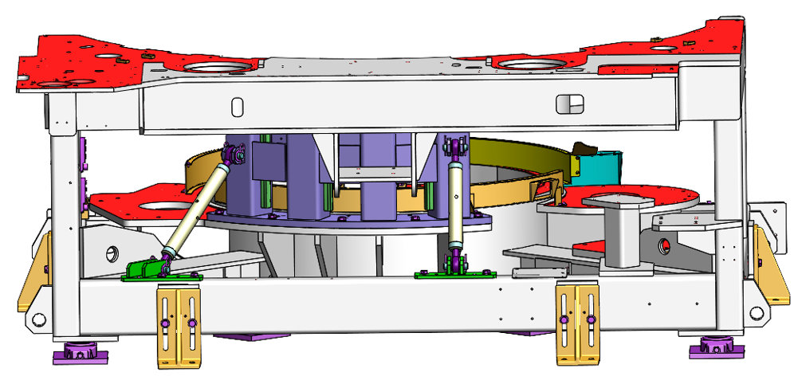
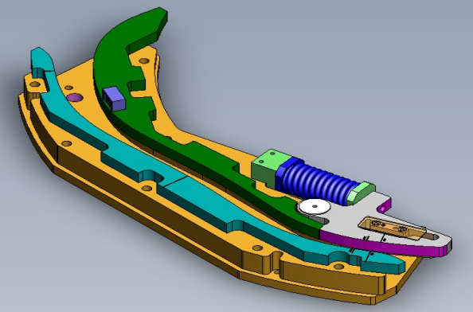

INCREASE YOUR BLOWER PRODUCTIVITY UP TO 16%
Matrix - Speed Up kit O&U ref #2045
Mx MM 110003 ➔ 110042
KEY FIGURES
Efficiency
Budget price:
150 k€ - 290 k€
BENEFITS
DESCRIPTION
Payback estimation:
Increase your production capacity through an optimized investment
Boost your machine productivity
up to + 16% depending on :
Equipment size / UPM type
        XS : up to 2700 bhm
        M : up to 2600 bhm
        L : up to 2500 bhm
Bottle size
Product application (water / CSD)
Blow wheel major evolution
  set of UPM & consoles
  cams & support : O/C , Base mold , L/UL
  motorization, drive pinion & belts
  brake drive, centralized greasing
  specific tooling for intervention
  transfer table oxy-cutting
  Frame / OC cam re-inforced
  Software upgrade
Preform feeder & Oven capacity
Packaging Process evaluation is mandatory
Diagnostic Visit mandatory
Obsolescence screening recommended
< 3 years
Installation time:
27 – 37 m*d
Machine downtime:
12 – 15 working days
Lead time to deliver:
22 weeks
*These data are approximate and not definitive, depending on your machine configuration.
Machine application:
2400
2500
Matrix MM - GM
NEW MM 110003 ➔ 110042
MM 210001 ➔ 210004
PH and HR excluded
2250
2600
2200
Can be bundle with:
2700
Easy feed #2003
Bearing Spindle Ch. #2004
Encoder Relocation #2061
Intelliadjust #2081

