Slide 1




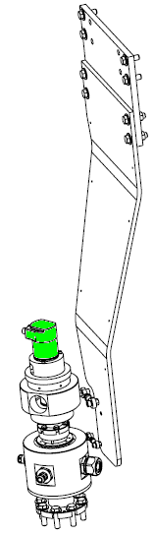
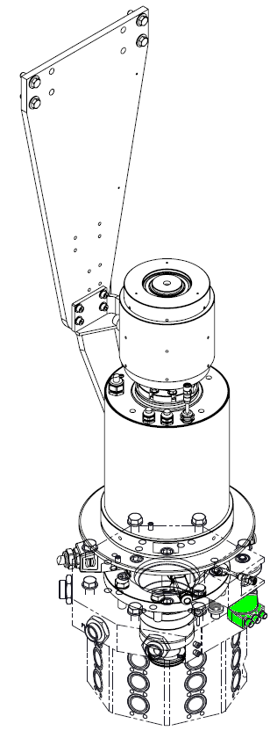
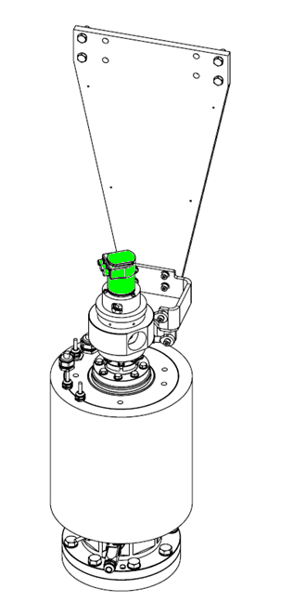
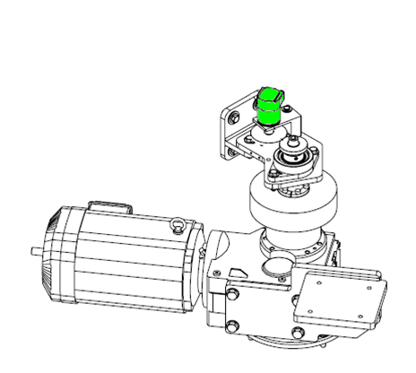

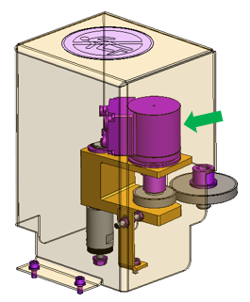
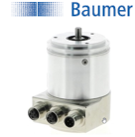
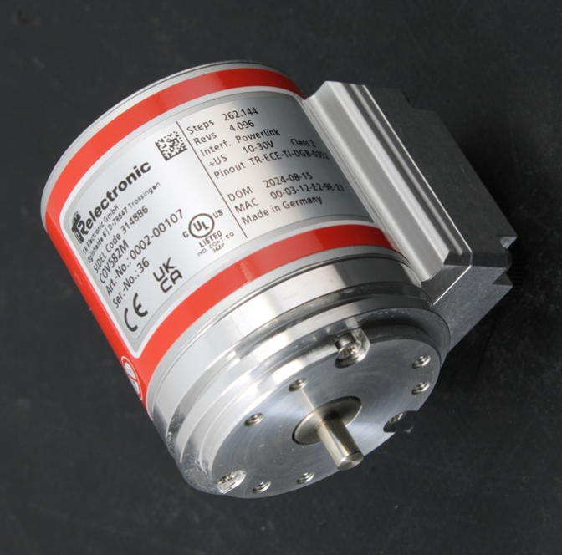

Secure your Matrix Blower uptime
Efficiency
O&U ref 2061 - Encoder relocation & BAUMER encoder obsolescence for Matrix
Obsolescence
KEY FIGURES
Budget price :
12 k€
DESCRIPTION
Encoder Relocation
Payback :
When located on the rotary union, central area of the blower, the encoder can be subject to vibrations generated by the blowing wheel rotation, that could
create misreading of the encoder which could lead to PLC synchronization errors (machine stoppage)
maintenance operation is difficult (access in height in a crowded area).
The encoder is relocated from the central area of the blowing wheel, to the moto-reductor driving shaft.
before
N/A : machine uptime
Installation time :
2 days / 2 m*d
Machine downtime :
BENEFITS
2 days
no more vibrations / communication issue from the encoder.
maintenance operation done at ground level, in an easy access area (operation in safe condition)
Encoder relocation will provide the replacement of obsolete encoder (Baumer) as well
new ABSOLUTE ENCODER D06 L10 IP65 – TR Electronics with specific gear train and bracket
new electrical link on electrical rotary union
Lead time to deliver :
10 weeks
* These data are approximate and not definitive, depending on your machine configuration.
Can be bundle with:
✓
✗
PCC Obsolescence #OCB006
HMI migration to W10 #2096
after
Machine application:
after
Matrix early generation
Encoder
Obsolescence

