Slide 1

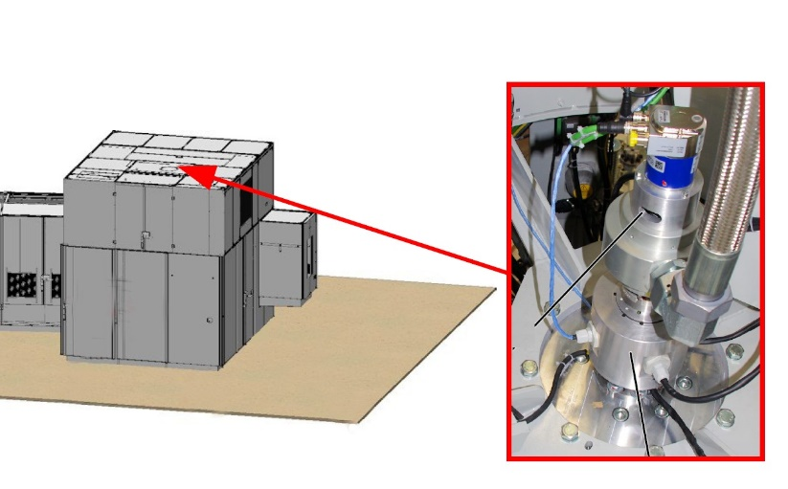
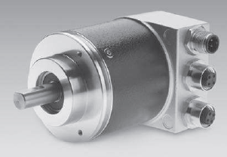
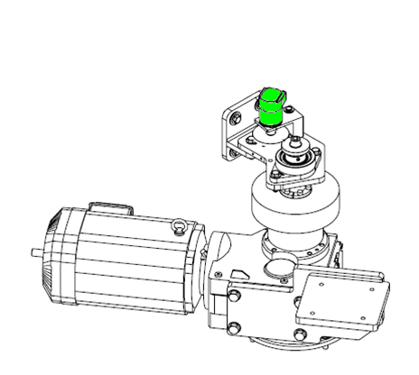
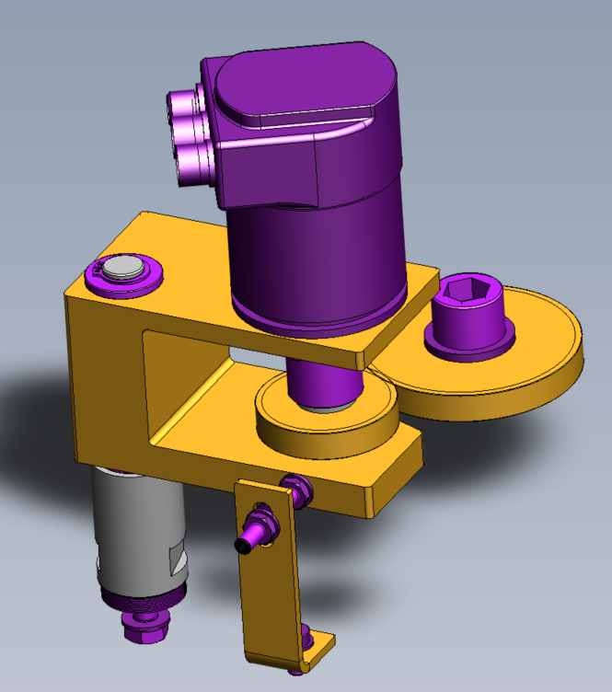
Secure equipment efficiency by cancelling encoder vibration risk
Encoder relocation
VALUE AND BENEFITS
DESCRIPTION
Cancel possible misreading of the encoder which could leads to PLC synchronization errors.
The encoder is relocated from the central area of the blowing wheel, to the motoreductor driving shaft.
New encoder with specific gear train and bracket
New electrical link on electrical rotary union
Value: Efficiency, Maintenance
Equipment: Earlier Matrix Blowers
Catalogue code: 2061

