Slide 1
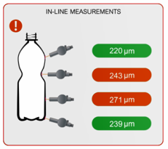
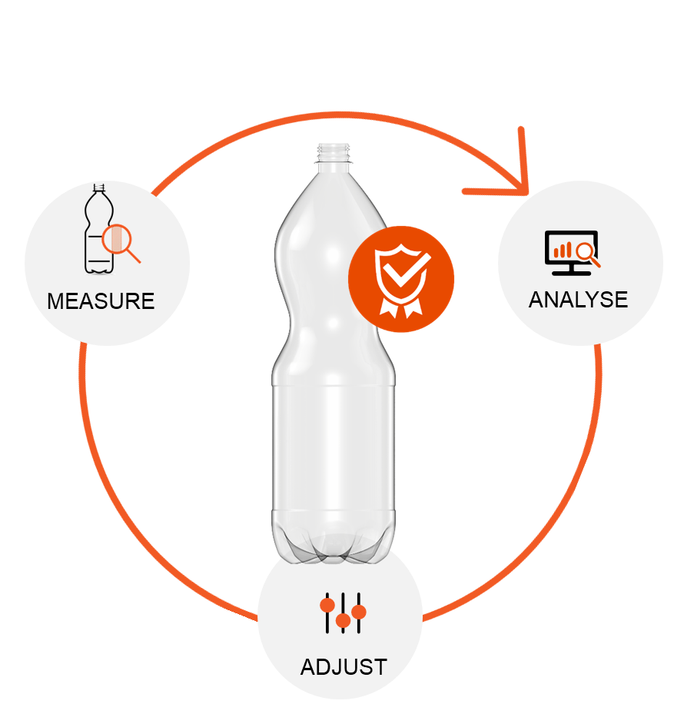
Sidel IntelliADJUST™ for Matrix
Product Quality
Ref. 2081
KEY FIGURES
Budget price:
BENEFITS
DESCRIPTION
Edit text style
275 k€*
GREATER BOTTLE QUALITY CONSISTENCY
Closed loop process control
Guaranteed bottle quality whatever the production conditions
EASY TO USE
Expert-free system
Calibration-free / Immediate start up : auto adjustment
MORE SUSTAINABLE
Less destructive lab controls
Eliminates scrap produced by inconsistent material distribution
COST EFFECTIVE
Reduced lab control
rPET quality deviation management
100% RELIABLE & CALIBRATION-FREE, across a wide range of preforms - translucent, colored, virgin resin or rPET
Precise one-side measurements using interferometric sensors
4 measuring points to secure consistent bottle quality
High-precision measurements +/- 2 µm
Combined with Vision system to check the bottle base injection point
Combined with Intelli-Blower
Auto optimization of preblow & heating
contents
Payback estimation:
2 years*
(lab hours savings)
Installation time:
11 to 19 men*days
Machine downtime:
4 to 9 days
(depending on blower initial configuration)
* Complete package for Matrix sbo 20 out of Iinstallation & Commissioning
ADVANCED SERVICES
Can be combined with:
DIGITAL and CONNECTED
Powered with Evo-ON
Advanced data analysis and statistics
Benchmark performance and parameter monitoring
Quartz bars zone1 - #2032
Oriented Lamps - #2086
Dual Entry Oven Ventilation - #2087
SIS Vision System #2063
Eligible to Try & Buy contract
Machine application:
Matrix
for cylindrical bottle only

