Slide 1

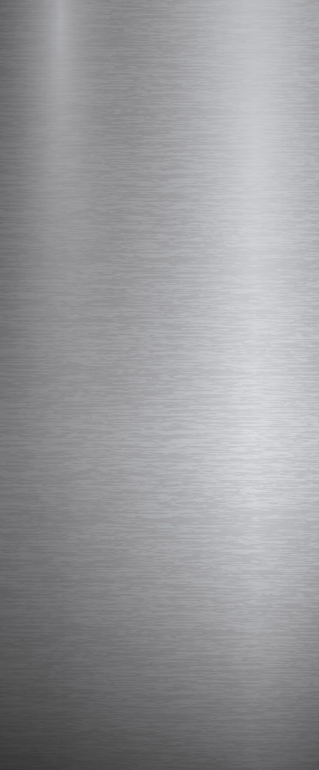


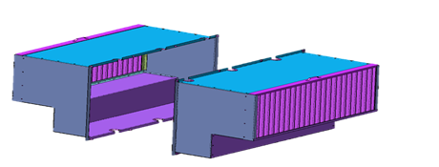
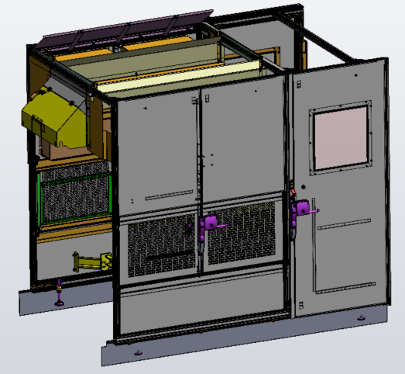
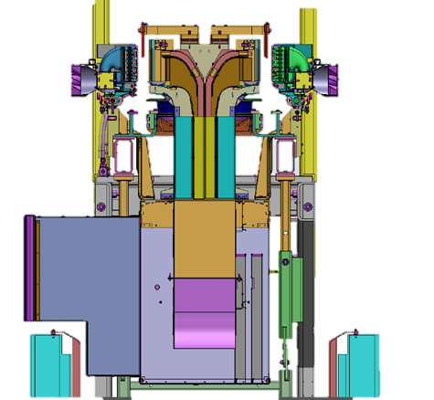
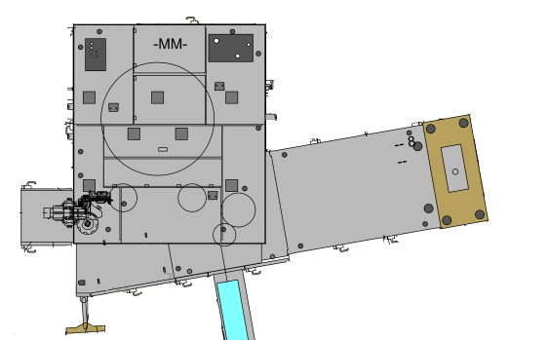
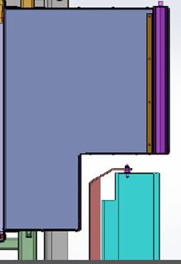
WIDEN THE PROCESS WINDOW for rPET CONVERSION
PRODUCT
QUALITY
KEY FIGURES
Ref. 2087 – Dual entry Oven ventilation for MATRIX Blower
Budget price:
BENEFITS
DESCRIPTION
RFQ : 10 k€ *
Because preform heating profile may need to be adapted for rPET resin…
Larger flow of air for preform ventilation in oven
Enlarge the process window for rPET conversion or new preform design, such as lightweight
Ease heating parameters for very technical bottle shape
An additional ventilation box is installed opposite to the existing single ventilation box.
Air inlet comes from both sides of the oven
Oven housing panels are changed to fit air inlet grids.
*example for 10 heating modules
Payback estimation:
Bottle Quality / Production scrap reduction.
Installation time:
Additionnal AIR BOX
4 MenDays **
Machine downtime:
2 days.*
Lead Time:
12 weeks
before
after
*according to equipment generation
or configuration.
** Installation not included in Budget price.
Complementary Process Engineer could be required
Can be combined with:
2nd AIR INLET
in oven housing
Quartz bars in zone 1 #2032
Oriented infrared lamp #2086
Anti-microparticules system on infeed rail #2082
Preform De-Dusting module #2011
Machine application:
Matrix

