Slide 1



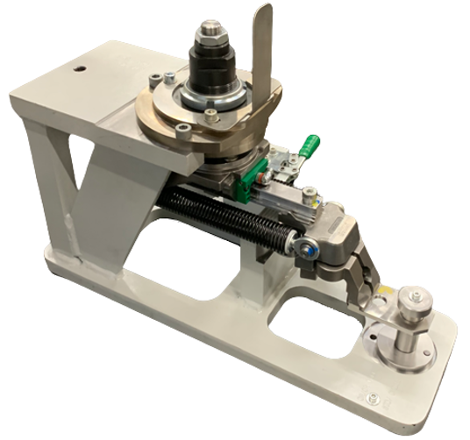
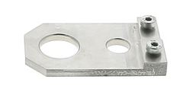
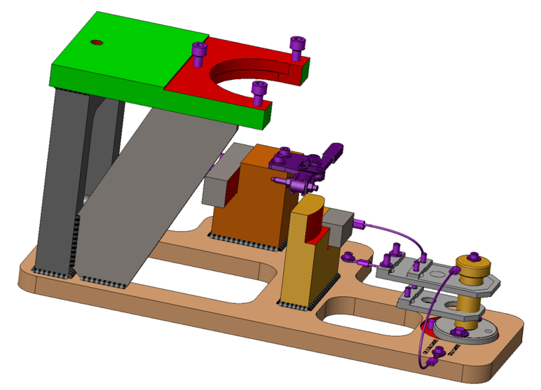
Enlarge your diagnosis capacity
MAINTENANCE
KEY FIGURES
O&U ref. 2089 – Jig for quick inspection of Transfer Arms
Budget price:
BENEFITS
DESCRIPTION
RFQ
Quick assessment of transfer arms geometry
Quick inspection of the transfer arm.
Ease of use
Consistency of the inspection.
Suitable for various types of arms * :
  Standard head
  Oriented head
  Controlled head
  Oriented and controlled head
  Bottle oriented arm excluded
Contribute to Production Efficiency
A simple Jig to be used during maintenance operation of transfer arms as well as when preform / bottle bad transfer is occurring
Check up to be performed on a workbench, outside of the machine.
GO / NO GO principle.
When the pin can not go in the dummy gripper,
        the geometry of the transfer arm is wrong.
        the suspected transfer arm must be replaced.
Payback estimation:
Production downtime reduction.
Installation time:
Not Applicable (tool)
Machine downtime:
Not Applicable (tool)
Lead Time:
10-12 weeks
Dummy gripper
Can be combined with:
(*) provide blower serial number for Quote
Visual Maintenance Management (TPM) #1028
Mold O/C lever with hydraulic clamp #2023
Bearing Spindle Chain #2004
Matrix Blowing Valve Cover fast dismantling #2094
Machine application:
Matrix Blower

