Slide 1




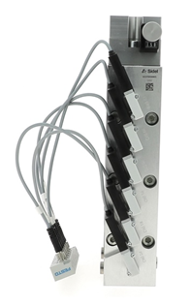
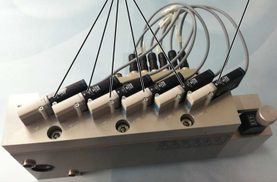
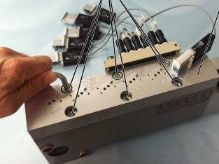
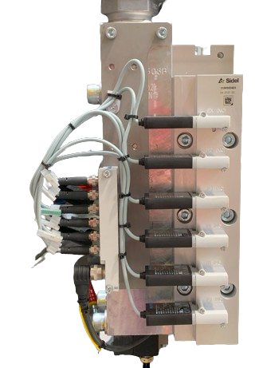
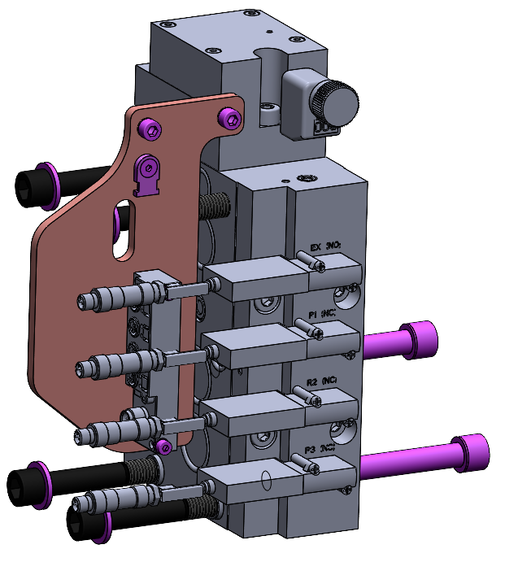
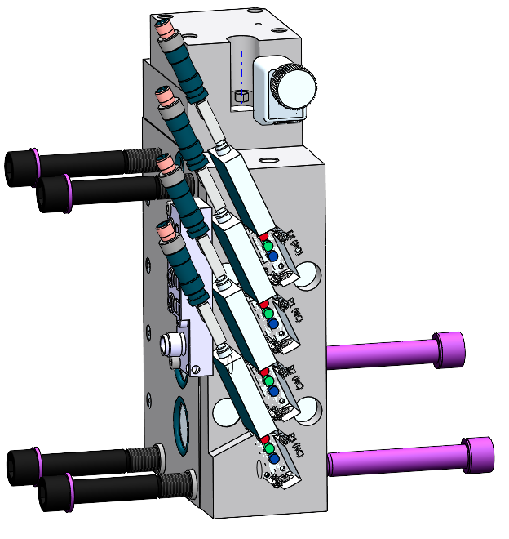
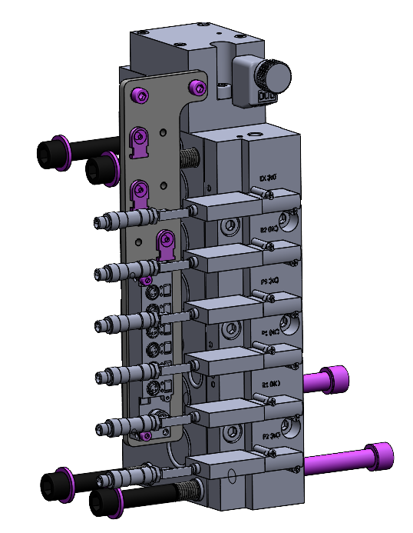
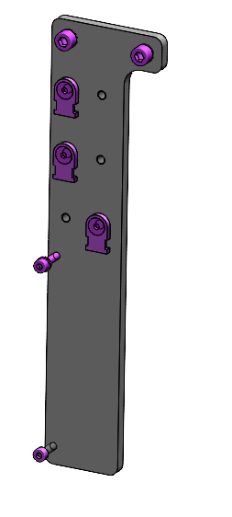
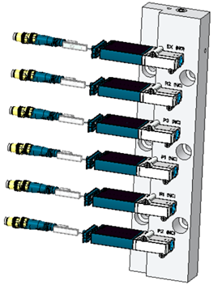
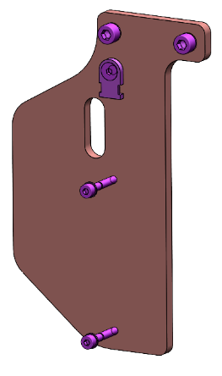

Combine easier maintenance & obsolescence
MAINTENANCE
KEY FIGURES
O&U ref. 2094 – Matrix Blowing Valve Cover fast dismantling
Budget price:
BENEFITS
DESCRIPTION
RFQ
25% time saving during Maintenance
of Matrix blower blowing valves
Maintenance can be carried out without dismantling each pilot from the valve.
reduced maintenance time.
avoid potential parts damages
(valve threads)
eliminate re-assembly mistakes
(valves pilot reversal)
New design of blowing valve cover to reduce dismantling steps during maintenance operation.
screws of blowing valves block are free from pilot layout.
Standard design of Matrix latest generation.
Plug & Play operation.
Saving : - 25% downtime of Blowing Valve maintenance operation
✗
Installation time:
1 ManDay **
Machine downtime:
1 days.*
Lead Time:
✗
✓
16 weeks
* * Installation not included in Budget price.
** Matrix 20 cavities / 1 operator
Holding plate for pilot wires & connector
Can be combined with:
Upgrade kit for 6 Blow
✓
AirEco2 #2015
Visual Maintenance Management (TPM) #1028
Mold O/C lever with hydraulic clamp #2023
easy access to screws to remove the cover and perform maintenance of valves
Upgrade kit for 4 Blow
Machine application:
Matrix equipped with 6Blow Block
or 4Blow Block
cover with new lay-out of valve pilot

