Slide 1



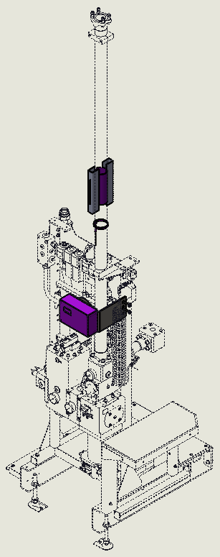
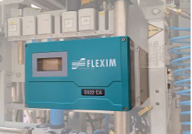
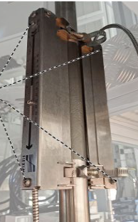
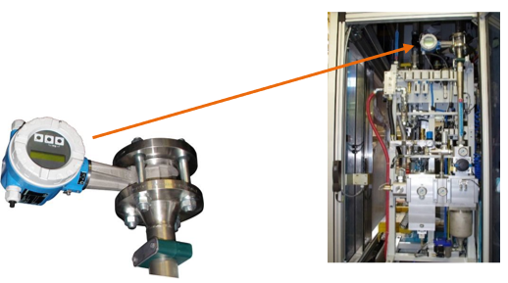
Keep an eye on your blower HP air consumption
EFFICIENCY
KEY FIGURES
Ref. 2095 – Ultrasonic Air Flowmeter
Budget price:
DESCRIPTION
27 k€
BENEFITS
High precision device
Non-intrusive compressed air flow measurement from 3 bar absolute onwards.
Precise air flow measurements, even on small size machine models.
Flow velocities as low as 0.01 m/s are detected. Bi-directional Measurement (able to detect back-flow), and not influenced by moisture, oil or dirt particles.
can process online measurement data from temperature and pressure sensors.
Easy detection of leakages and load peaks.
Simple and cost-effective retrofitting with short time equipment shut down.
Easy to install
Compact compressed air ultrasonic flowmeter with integrated standard volume flow calculation :
Based on pipe geometry parameters and the physical properties of the fluid, the transmitter calculates the system’s volumetric flow rate.
The transmitter is connected to the machine's 24 V supply and the data are transmitted to the HMI.
Payback estimation:
Not applicable.
Installation time:
2 MenDays *
Machine downtime:
0,5 day.
Delivery Lead Time:
12 weeks
* Installation not included in Budget price.
Can be combined with:
Cloud Connectivity #DIG009
AirEco2 #2015
Eco-Audit #AU05-1 / 2 / 3
former design
AIR SUPPLY 40B 1"1/2
2’’
2"1/2
Machine application:
new Ultrasonic HP air flowmeter
Matrix blower

