Slide 1
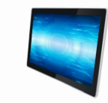
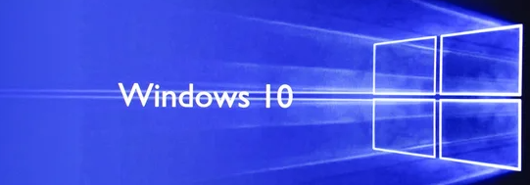
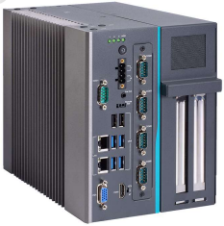
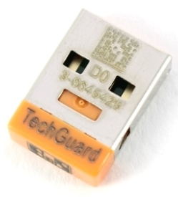
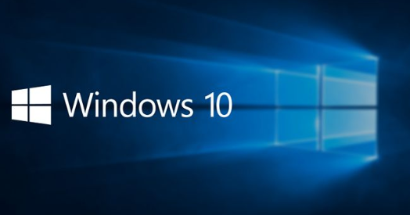
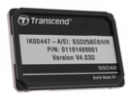
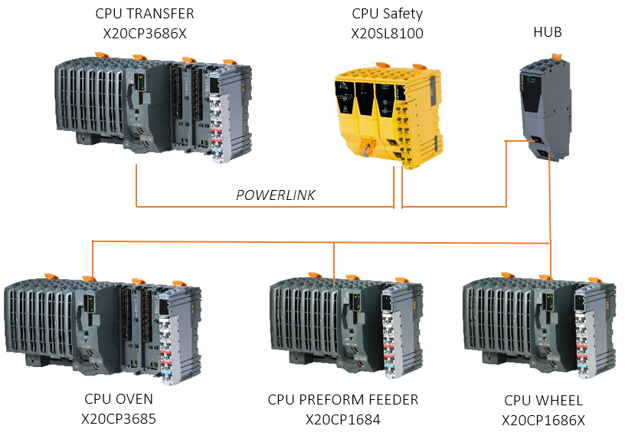
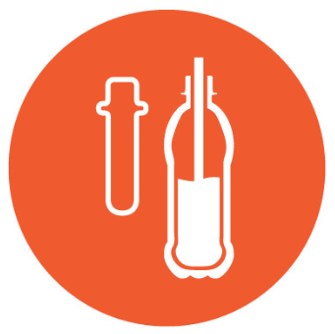
OPERATE YOUR BUSINESS SAFELY
SAFETY & ERGONOMY
Ref. 2096 - HMI migration to Windows 10 for MATRIX Blower
KEY FIGURES
Budget price:
BENEFITS
DESCRIPTION
23-45k€ *
Upgrading your HMI to Windows 10 is your best bet to stay safe from the ever-evolving threats from viruses.
System updates for a longer period
W10 force automatic updates
Excellent virus protection
Lighter and faster operating system
Defense countermeasures and patching systems
Cyber Security & industrial control systems.
Reduce damages and harms caused by human error / external devices connection
It’s time to upgrade to Windows10
Depending on current configuration of your equipment, the proposed kit to migrate your HMI to W10 include:
New HD - New Eprom Security controls up to date. (patching and hardening)
New Touchscreen + PC IPC962HR / APC910
CPUs Wheel / Oven / Transfer / Preform Feeder / Safety
Payback estimation:
Not applicable.
Installation time:
3 to 8 MenDays *
Machine downtime:
3 to 8 days.**
*according to blower size and scope.
** Installation not included.
Can be combined with:
Cloud Connectivity #DIG009
Machine application:
Matrix
In case of Blower in COMBI configuration, it is mandatory to upgrade also the Filler with Windows 10.

