Slide 1
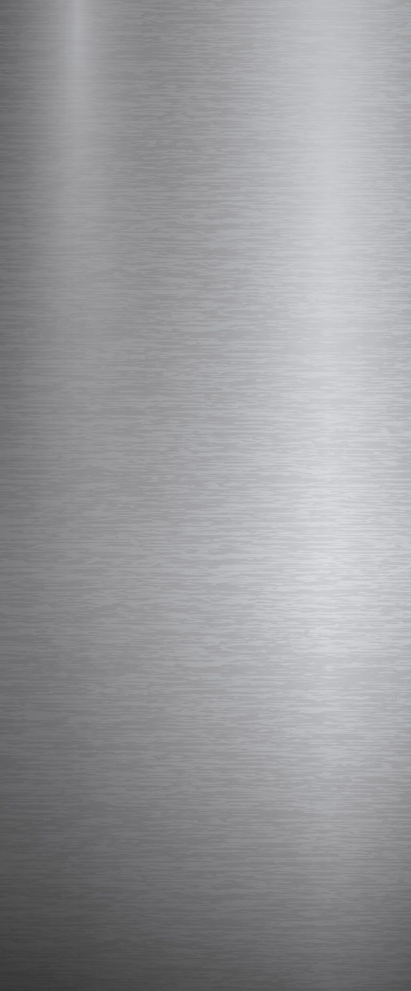


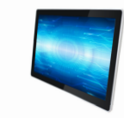
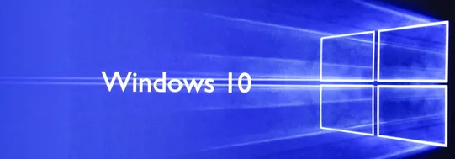
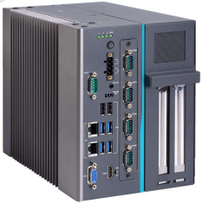

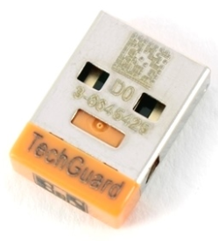
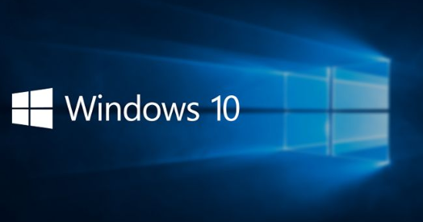
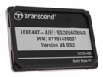

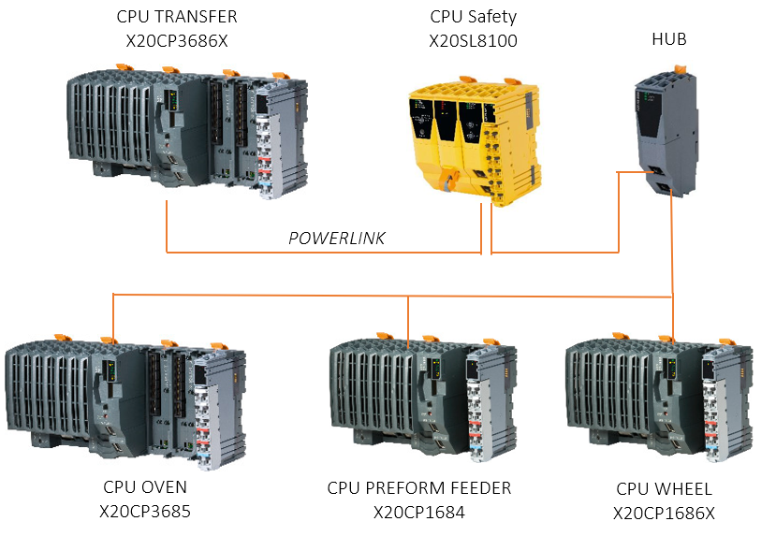

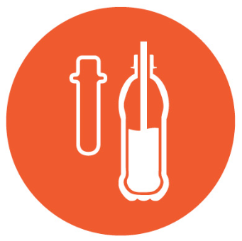
OPERATE YOUR BUSINESS SAFELY
SAFETY & ERGONOMY
Ref. 2096 - HMI migration to Windows 10 for MATRIX Blower
KEY FIGURES
Budget price:
BENEFITS
DESCRIPTION
RFQ : 23-56k€ *
Upgrading your HMI to Windows 10 is your best bet to stay safe from the ever-evolving threats from viruses.
System updates for a longer period
Cybersecurity features with excellent virus protection
20% faster operating system
Image higher quality
Improved Heat Resistance (when new PCC)
Defense countermeasures and patching systems
Reduce damages and harms caused by human error / external devices connection.
It’s time to upgrade to Windows10
Depending on current configuration of your equipment, the proposed kit to migrate your HMI to W10 include:
New HD - New Eprom
Security controls up to date. (patching and hardening)
New Touchscreen + PC
IPC962HR / APC910
CPUs Wheel / Oven / Transfer / Preform Feeder / Safety
Payback estimation:
Not applicable.
Installation time:
1 to 5 MenDays **
Machine downtime:
1 to 5 days.*
Lead Time:
12 weeks
*according to equipment generation
or configuration.
** Installation not included in Budget price.
Can be combined with:
Cloud Connectivity #DIG009
Machine application:
Matrix
In case of Blower in COMBI configuration, it is mandatory to upgrade also the Filler with Windows 10.

