Slide 1




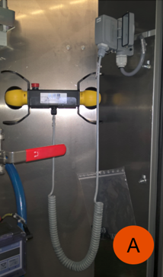

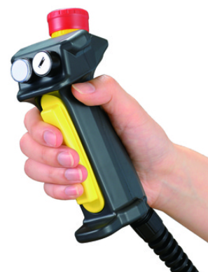
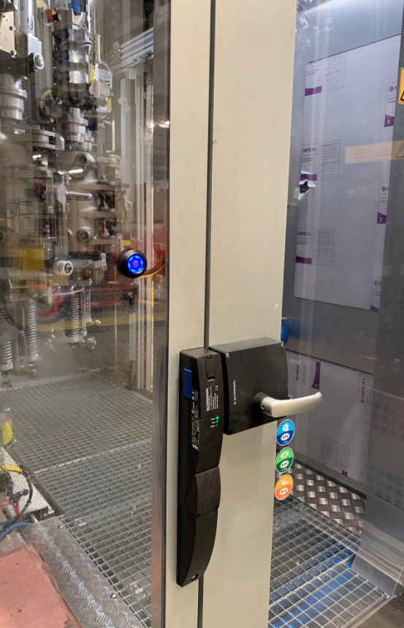
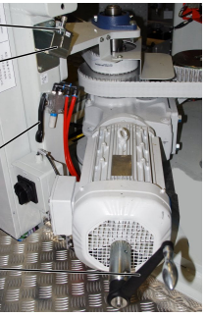
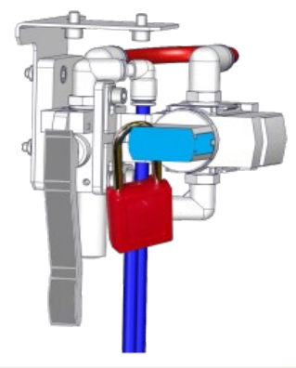
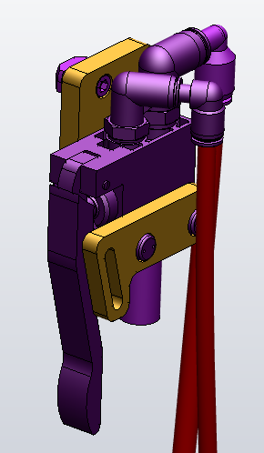

Secure operations inside your Blower
Human Safety
Aseptic Equipment compliant
KEY FIGURES
O&U ref 2098 - JOG All Door Closed & Lockable brake release for Matrix
Budget price:
BENEFITS
DESCRITPION
7k€
RAISE SAFETY LEVEL for OPERATORS when INSIDE THE BLOWER
JOG All Doors Closed
  authorizing blower to rotate in JOG mode only with ALL DOORS CLOSED.
  using Push button on housing doors instead of Jog lever, to rotate the machine.
Lockable Pneumatic valve of the brake circuit
  restrict the use of manual rotation of the machine, with padlock in / out under Supervisor control.
MATRIX blower
Software modifications
Memory card
HD drive
Push button on doors / light indicator
Original Jog lever remains in place but not used anymore
Lockable Pneumatic valve with push lever
Air connectors, hoses, brackets
Saving : N/A
Safety feature
before
Installation time:
2 MenDays *
Machine downtime:
2 days.*
Lead Time:
8 weeks.
* depending on equipment configuration.
Lockable brake
Can be bundle with:
after
LED lightning #2043
Mold O/C lever with hydraulic clamp #2023
Bottle switch system #2020
Machine application:
Matrix
padlock
before
after : use door button for Jog rotation

