Slide 1




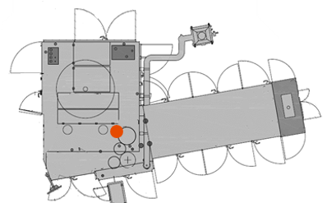
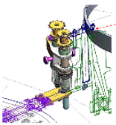
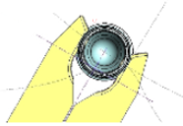
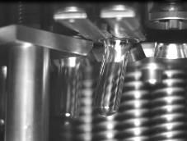
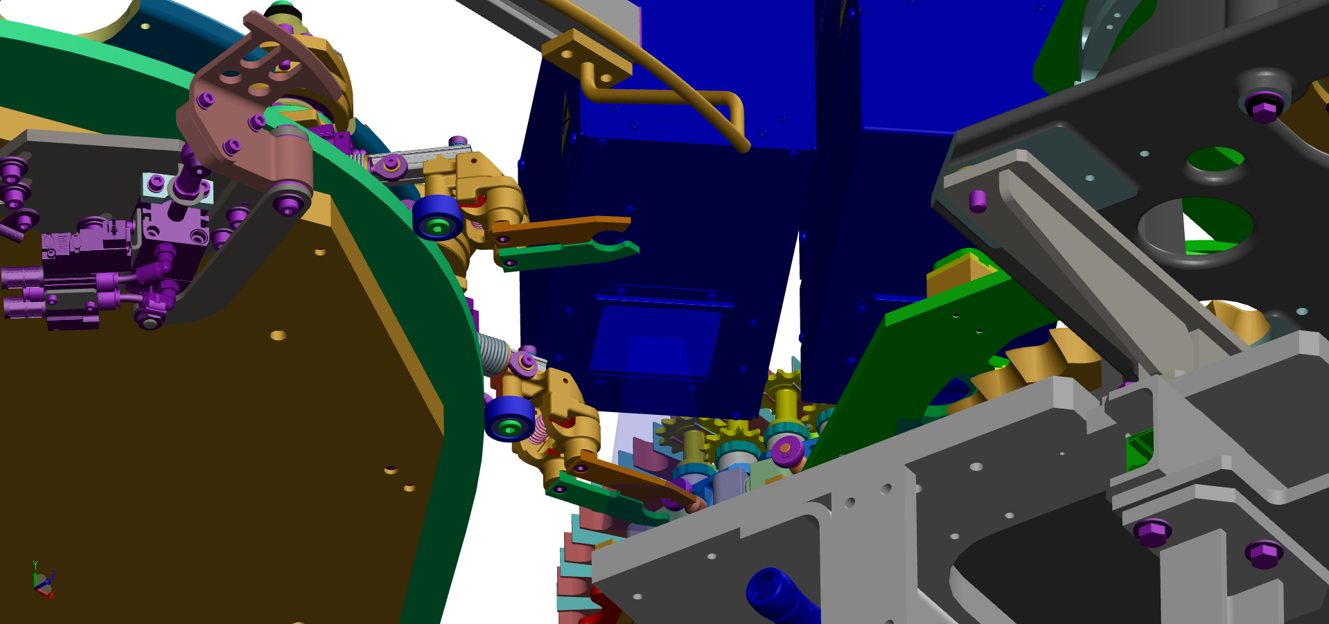
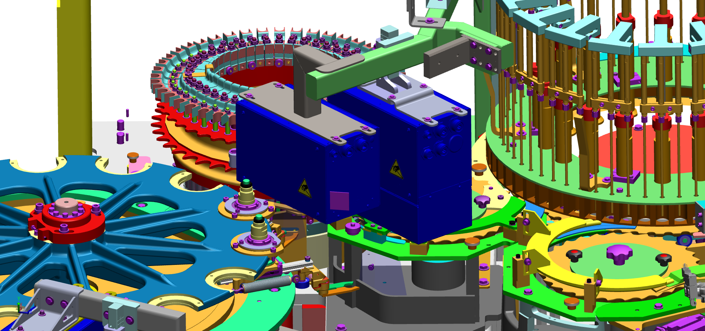
Secure Preform Transfer of your Matrix Blower
Efficiency
O&U ref 2104 - Preform Transfer Handling vision control
Aseptic Equipment compliant
KEY FIGURES
Budget price :
BENEFITS
24 k€ - 55 k€* RFQ **
Lightweight neck and/or R-PET conversion can bring along preform lower quality. Among others issues observed, preform loading and unloading may become critical steps, resulting in preform tilting or shaking when unloaded from spindle.
Avoid frequent production downtime and massive loss of bottles & preforms.
Avoid blower downgraded behavior due to frequent critical crashes.
Information at HMI about spindle and transfer arm number involved in mis-gripping, to ease preventive maintenance / troubleshooting action.
Payback : <1 year
65 000 b/h 4500h/y production 1 stop / shift x3 av. 6mn per stop
bottle/preform value: 0,02 euros
Installation time :
2 days / 6 m*d
Vision expert FSE recommended
Machine downtime :
DESCRIPTION
2 days
An inspection module and its bracket is located at the oven outlet to detect mis-gripped preforms that may cause frequent transfer issues like preform dropping at oven outlet or mold not locked default, leading to blower critical stoppage.
detected mis-gripped preforms are ejected at preform transfer as a faulty preform.
PTH vision control can be fitted with Pressco S5i or SIS-V6 or SSV Cognex camera, depending on blower existing configuration or generation.
software version upgrade may be required, with potential hardware upgrade.
includes set of black coated preform grippers.
Lead time to deliver :
18 weeks
* depending machine configuration already equipped with inspection system.
** machine not already equipped with inspection system.
Can be bundle with:
PTH vision
2 steps unloading cam #2084
Quartz bars #2032
Dual entry oven ventilation #2087
Deflector inside preform hopper #2067
vision control zone of gripped Preform
Machine application:
mis-gripped Preform Ejection
mis-gripped Preform
Matrix blower
PSE vision

