Slide 1
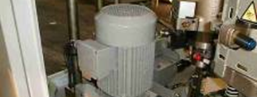
Reduce your maintenance costs related to the use of a direct-current motor
AC motor
VALUE AND BENEFITS |  | DESCRIPTION
Reduce maintenance costs (related to brush replacement) and increase motor lifespan and reliability |  | Replace the original DC Motor reducer and electronic controller with an AC Motor reducer and a frequency controller
DESCRIPTION
Value: Obsolescence
Equipment: Series 1 blowers (SBO 4/4 - SBO 4/6 - SBO 6/6 - SBO 6/10 - SBO 10/10 - SBO 10/14 - SBO 16 - SBO 24/24 - SBO 24/26 - SBO 32/26 - SBO 48/38)
Catalogue code: 357

