Slide 1



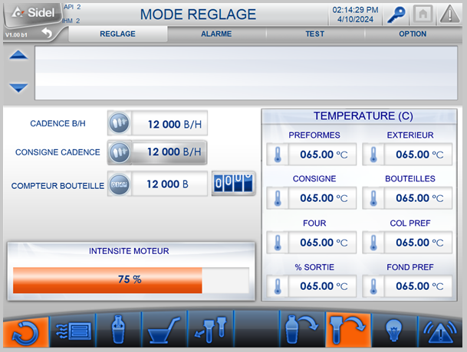
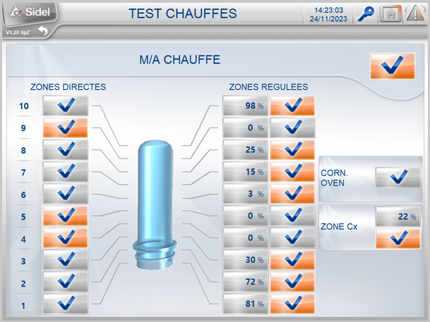
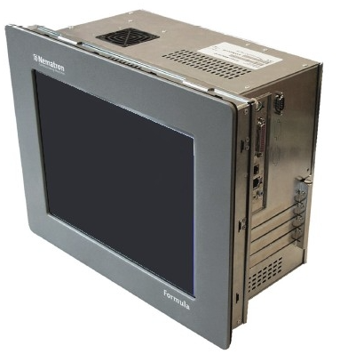
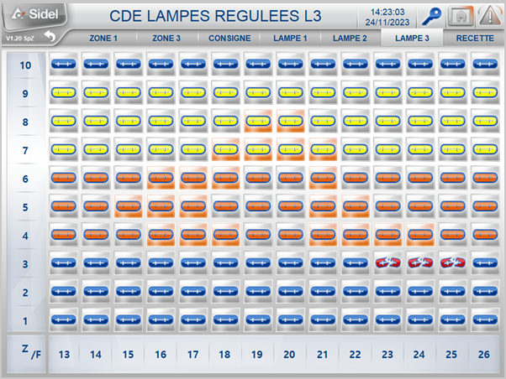
SERIES1 PCC OBSOLESCENCE
Formula 1 PCC windows 10 - O&U ref 415
replacement of PCC IWS or former PCC F1
OBSOLESCENCE
KEY FIGURES
Budget price:
25 k€ - 30 k€
BENEFITS
DESCRITPION
Increased speed and ease to use.
Instant view of HMI pages.
Increased visibility thanks to the latest visual from the Matrix platform.
All advantages of Windows 10
system updates for a longer period
excellent virus protection
lighter and faster operating system
PC Formula IF5008 Panel PC
equiped with
      Licences OS/Win10
      ServerOPC/SIEM
      Citect/Win10
Same design and dimensions as former F1
Requires PCC panel head adaptation if the upgrades is from the original PCC (IWS).
x.
Screen shots of new HMI
Payback estimation:
Equipment lifecycle
Installation time:
1 man*day
Machine downtime:
1 day
Can be combined with:
PLC S5/S7 Conversion #423
TE 300 Heat Controller #991S1
AC Motor #357
Note:
OS software is covering key functionalities of the equipment to allow equipment uptime.
Some initial specific functionalities may not be active anymore after this upgrade.
Machine application:
Series1 equiped with PCC
SBO 1 – SBO 2 excluded

