Slide 1
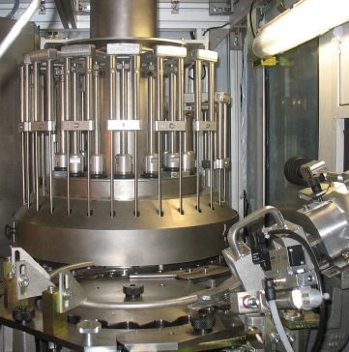
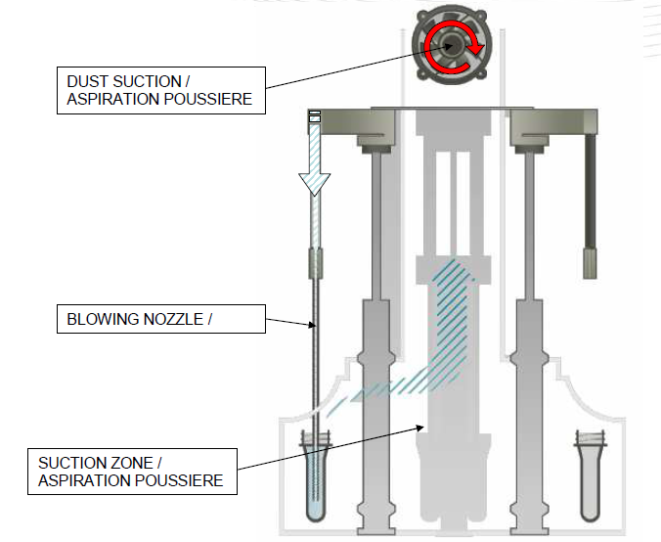
Secure preform and final product hygiene
Preform de-dusting module
VALUE AND BENEFITS
DESCRIPTION
The system is eliminating any residual particles from preforms (more than 97% for PET dust)
Enables preforms to be cleaned internally before blowing
The module eliminates by filtered air flow the solid particles which may accumulate inside the preforms
The air suction hood comprises a turbine fan in a sealed housing, a particle filter and two baffles to channel air suction flow
Value: Product quality
Equipment: blowers Series 2
Catalogue code: 506

