Slide 1
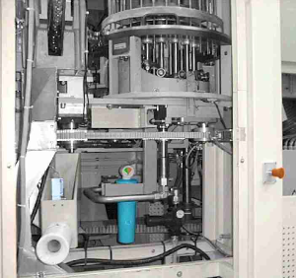
Increase hygiene level
Preform dedusting
VALUE AND BENEFITS
DESCRIPTION
Enables preforms to be cleaned internally before blowing
Filtered air (at 2 bars' pressure) is injected into the preforms, ensuring that any solid particles present are removed.
The dedust wheel comprises 30 injectors which blow compressed air directly (at 2 bars' pressure) into the preforms, eliminating any residual particles
The air suction hood comprises a turbine fan in a sealed housing, a particle filter and two baffles to channel air suction flow
The wheel comprises a slotted table an external guide and transfers the dedusted preforms to the oven wheel
Independently of the air supply for the machine air cylinders, the compressed air system provides a high level of filtration using a prefilter, a filter and an total filter. It also brings down air pressure from 7 bars to 2 bars
Drive for the rotation of the feed wheel, the dedust wheel and the transfer wheel is provided by a belt itself driven by the oven transmission shaft
Value: Product Quality
Equipment: Series 2 blowers
Catalogue code: 506

