Slide 1
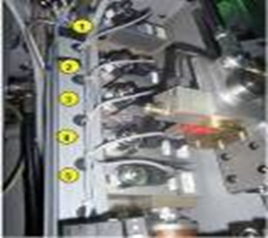
Recover up to 60% of blowing air
ARK: Air Recovery Kit for Heat Resistant Process
VALUE AND BENEFITS |  | DESCRIPTION
With the air recovery option, more than half of the used air is collected and converted into preblow, service air and used to generate air for the factory Another criteria to consider, is the Excellent integration into machine: The settings linked to the recovery option are recorded into the process recipes Reduced investments, thanks to smaller air compressors Recover up to 60% of the air consumed for the production of heat-set bottles |  | The amount of recovered air is linked to the type of blowers and depends also on the production conditions Machine rate, number of blowing stations, preblow and blow pressure, bottle capacity The recovered air could be re-used to generate Preblow air Stretching and nozzle cylinders air Low pressure air out of the machine (the blower acts as a LP compressor The minimum required PCC version to install this O&U is V2.02; for prior versions, an update of the PCC is mandatory
DESCRIPTION
Value: Cost Optimisation, Sustainability
Equipment: Series 2 blowers with HR process
Catalogue code: 576

