Slide 1
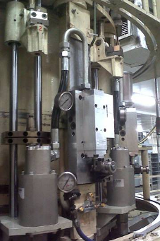
Improve the Series 1 nozzle assembly
12_84
Series 2 nozzle cylinders for Series 1
VALUE AND BENEFITS |  | DESCRIPTION
Process Allows lighter preforms to be blown Helps reduce loss of shape for neck finishes The timing of the rise of the nozzle is adjustable (a few degrees) Neck finish is more protected during blowing process Maintenance Cost reduction: No need to maintain or replace the cams (bars) and the nozzle carriers Time dedicated to maintenance is reduced Nozzle cylinders are easier to maintain (a specific seal kit exists) Savings Reduces blowing air leaks Each nozzle block is assembled in our workshop to reduce machine downtime |  | Series 2 blowing cylinder fed by a new blowing tube A circuit selector is installed on each strut and controls the lower chamber of the cylinder
Blowing tube
S2 Nozzle cylinder
Circuit selector
Value: Efficiency, Product Quality
Equipment: Series 1 blowers (SBO 10, SBO 16)
Catalogue code: 898

