Slide 1
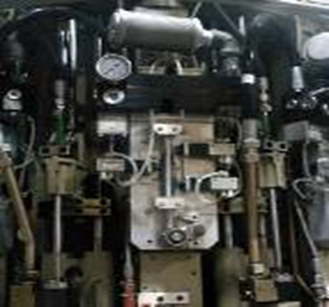
Reduce air consumption and maintenance costs and improve reliability
Twister blocks
VALUE AND BENEFITS |  | DESCRIPTION
More sustainable: No air leaks, reduced dead volume (preblowing and blowing) Lower maintenance costs: Cheaper wearing parts (save up to 1,380 €/ year), extended number of blowing cycles (theoretically by up top 100% compared to the previous version) Proven technology: Upgrade based and currently used on Universal Blowers |  | Time needed for conversion reduced to the minimum: Equivalent air ports (preblowing and blowing), block fully assembled in our workshop (reduce the machine downtime), no modification of the electrical diagram or of the PLC software. Available versions: Central or low position exhaust, with or without Air Recovery Kit
DESCRIPTION
Value: Cost Optimisation, Efficiency, Product Quality
Equipment: Series 1 blowers (SBO 10, SBO 16, SBO 24/26)
Catalogue code: 899

