Slide 1
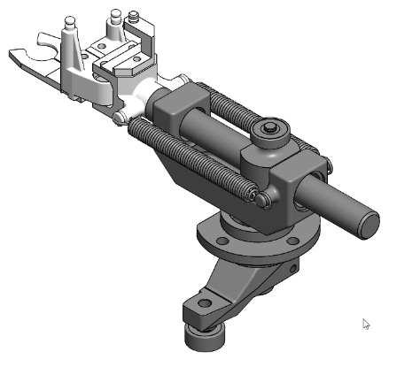
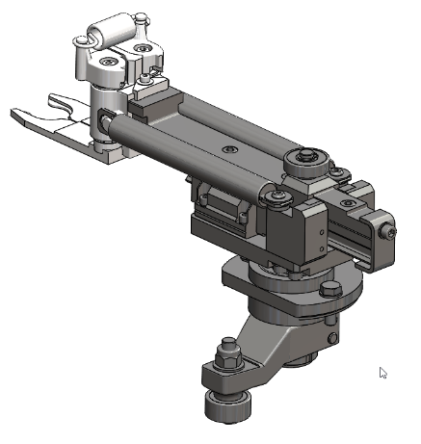
Increase your equipment efficiency
Transfer arm with linear guide
VALUE AND BENEFITS
DESCRIPTION
The latest technology made available on S1
High positioning accuracy:
vibrations and bending at the end of the gripper are reduced.
springs repositioned for operation within their working range
no risk of adjustment errors.
Easy to maintain, longer service life, cleaner
lubrication of the guide to be undertaken every 6 years for a rate of 1200 b / h / m.
reduction in maintenance costs and time
environment of the transfer function made cleaner
A lighter arm increases as well the life of cams and rollers:
aluminium guide rail
optimized support
total weight reduced by about 1.2kg
The roller guided transfer arm replaces the S1 self lube bushing guided arm.
includes S2 quick change head, grippers and setting jig.
available as well with S1 quick change head.
Value: Efficiency
Equipment: Series 1 blowers (SBO 4 - SBO 6 - SBO 10 - SBO 16 - SBO 24/26)
Catalogue code: 912

