Slide 1



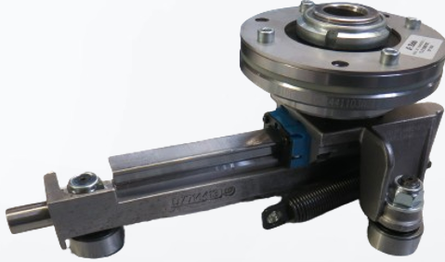


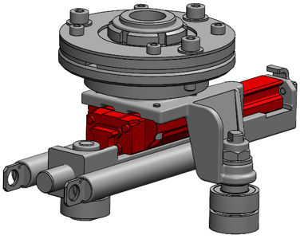
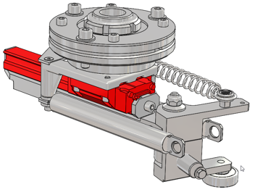
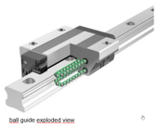
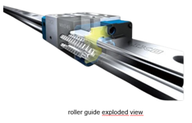
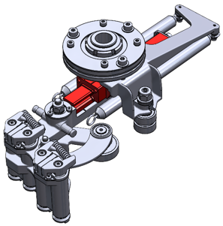
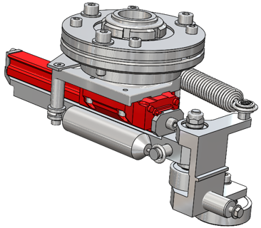
Increase your equipment efficiency
Maintenance
Transfer arms with linear rolling guides for S2 - O&U ref 914
KEY FIGURES
Budget price:
BENEFITS
DESCRITPION
1,7 k€ / standard arm x1​
RFQ for non standard arm
High precision positioning:
  vibrations and bending at the extremity of the gripper are reduced.
  no risk of adjustment errors.
Easy to maintain, longer service life, cleaner
  the longest possible maintenance free intervals provided by IKO technology.
  reduction in maintenance costs and time
    lubrication of the guide required only every 3 years (output rate 1800 b/h/m).
  environment of the transfer function made cleaner
  latest integrated upgraded design
All types of arms are considered.
  standard arms(single and double track cams)
  orientated arm assembly (single and double track cams)
  orientated arm assembly with control grip
  dual cavities
Replacement of the original transfer arms fitted with linear ball guides by transfer arms fitted with linear rolling guides.
  preventive maintenance after 20 000 km of back & forth movements.
  Cleanliness & best performances.
Payback estimation:
Maintenance downtime
Installation time:
5 hours for a sbo 20
or 15mn / arm
Machine downtime:
before
after
5 hours for a sbo 20
or 15mn / arm
Standard arm
Orientated arm
*click to edit
Can be combined with:
Double track transfer cam #531
Nozzle-Up safety cam #502
Arm for dual cavities
  Orientated arm with controlled gripper
Machine application:
Serie 2 - all configurations

