Slide 1
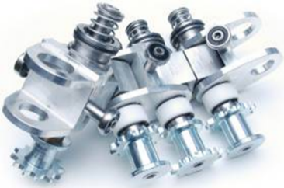
Increase chain lifetime by 50%
Long life spindle chain (snap head technology)
VALUE AND BENEFITS |  | DESCRIPTION
This new solution, combined with the use of new materials (polyacetal and ertalythe), significantly decreases stretching of the chain and increases chain lifetime by 50% The use of these new raw materials also reduces friction and eliminates all contamination. The result is up to 30% less maintenance costs |  | Average lifetime is 18,000 hours or 3 years Improved stretching resistance means better synchronization during preform transfer Optimized link piece profile to prevent friction Polyacetal ring for a better contact with the tensioner wheel Inner spring guide ring made of Ertalyte: Prevents wear of self-lubricated bushing Maintenance plan and kit available Quick change and non-quick change versions are available Can be installed in place of the standard chain
DESCRIPTION
Value: Cost Optimisation, Efficiency, Obsolescence
Equipment: Series 2 blowers (MM, GM, TM, oven pitch 40 or 50mm, preferential heating oven, guided type (W bearing))
Catalogue code: 967

