Slide 1
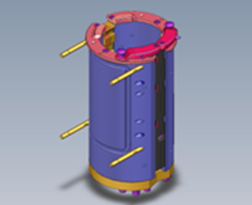
Significant decrease in changeover times
Bottle Switch™ Series 2 – Pack 2
VALUE AND BENEFITS |  | DESCRIPTION
Efficiency: 50% less production downtime with only one operator Cost optimisation: Less downtime means better TCO Safety: Semi-automated system with fewer manual operations Simplicity and ergonomics: Tool-free operations and easy access to parts |  | Sidel's patented Bottle Switch™ improves blow-moulder flexibility by reducing the mould changeover time to less than a minute, cutting downtime in half. This semi-automatic solution is easy for operators and requires no tools. The Bottle Switch™ is declined in 5 packs to match to customer needs. The Pack 2 contains a set of mould body changeover
DESCRIPTION
Value: Flexibility
Equipment: Series 2 blowers (MM GM Series 2 (cylindrical GUPM, SBO non HR))
Catalogue code: 968P2

