Slide 1
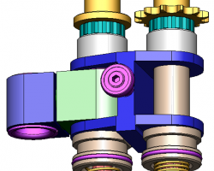
Reduce maintenance expenses on the spindle chain
Bearing spindle chain on Series 2
VALUE AND BENEFITS
DESCRIPTION
Extend the life span from 12,000 hours to 24,000 hours
This means increased machine availability and less maintenance
Note: The life of the chain depends on the type of oven, the number of modules and the machine environment (heat, dust, humidity)
V bearing and Hepco guide = better alignment
H made of aluminium
Links in stainless steel
Spring diameter: 1.8mm
Shaft diameter: 14mm
Pinion: case hardened with a nitrogen treatment
 | Maintenance operation
 | Standard spindle chain | Full bearing spindle chain
6,000 hours | Refurbishment | No maintenance
12,000 hours | Replacement | No maintenance
18,000 hours | Refurbishment | No maintenance
24,000 hours | Replacement | Replacement
Value: Cost Optimisation, Efficiency, Maintenence
Equipment: Series 2 blowers
Catalogue code: 977

