Slide 1



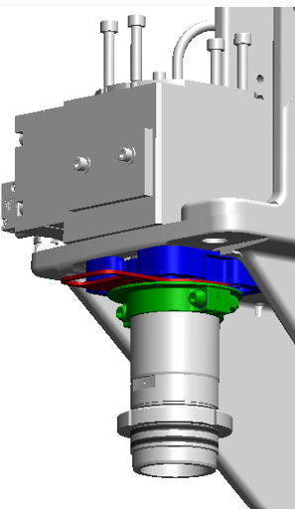
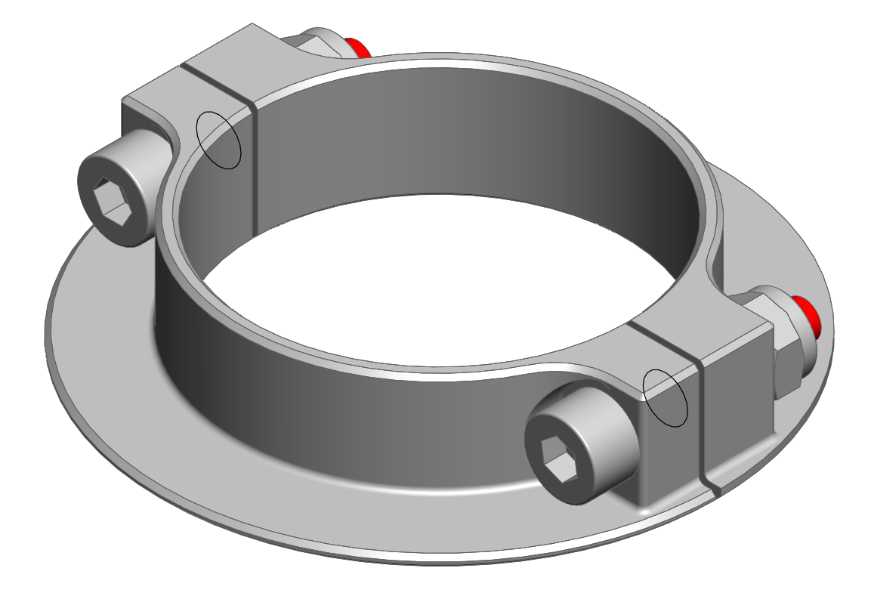
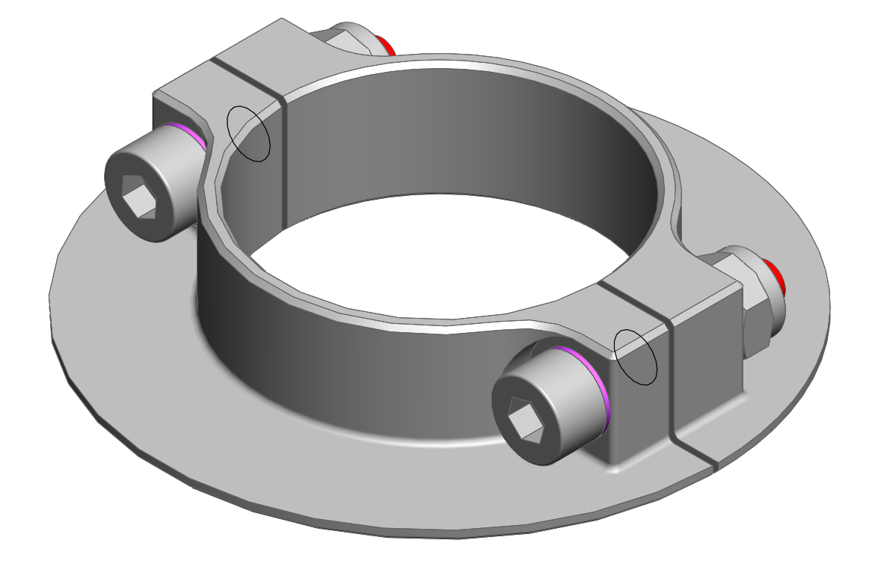
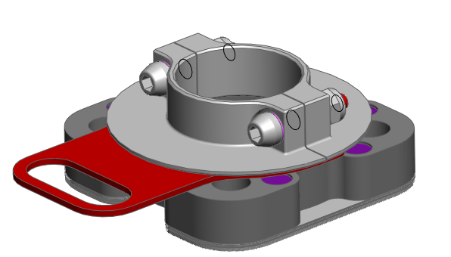
Hold Blowing Nozzle Up during Maintenance
MAINTENANCE
KEY FIGURES
O&U ref. 997 – Magnetic Holding device for Blow Nozzle cylinder
Budget price:
BENEFITS
DESCRIPTION
0,9 k€ / unit 18 k€ for 20 cavities
Ease maintenance operations: avoid blow nozzle cylinder self dropping, and so, avoid interference / damage with transfer grippers.
Easy to install
Can be installed on all or only some of the stations without drilling.
No electrical modification.
No lubrification required.
No risk of pollution as there is no friction between parts, and bolt-nuts are secured.
When the machine is stopped and de-energized, the blow nozzle cylinder may slowly go down due by its own weight and lack of seal friction.
The mobile part, attracted by magnets, remains in upper position.
The magnetic part is set with the screws of the blow nozzle cylinder.
The cylinder rod is hold in up position by two half-flanges, clamped on it, attracted by magnets.
Includes a U shape tool to adjust the air gap.
Blow nozzle cylinder
ROI : N/A ease maintenance «run to fail»
Installation time:
0,25h / station**
Machine downtime:
0,5 day.*
Lead Time:
12 -14 weeks
* * Installation not included in Budget price.
** Matrix 20 cavities / 1 operator
Calibrated U plate, as a tool to adjust the air gap.
Can be combined with:
Nozzle Safety cam #502
Universal nozzle on S2 #580
DLC locking pin #960
Universal Base mold for S2 #975
Bearing Spindle Chain #977
Ø50
Ø40
Clamp free to rotate with the cylinder rod.
Machine application:
same external diameter for Ø40 and Ø50
Clamping screw with calibrated rupture feature
Blower S2

