Slide 1
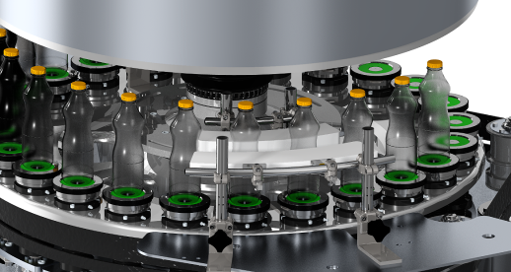
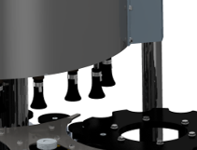
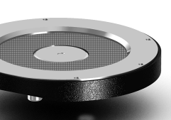
Increase equipment efficiency
Guides for Lightweight Bottles
VALUE AND BENEFITS |  | DESCRIPTION
Increased operational speed Reduced number of labeler stoppages Long life, maintenance-free |  | Kit description: New guides in low-friction plastic easily adjustable to keep the bottles stable, preventing their ejection from the platform base New centering bells internally shaped to fit the bottle top for good bottle retention. New platform bases made from milled stainless steel to increase the friction with the bottle base, thus increasing bottle stability
DESCRIPTION
Value: Efficiency
Equipment: Labellers (Rollfed F25, F35 and F45 )
Catalogue code: AA16

