Slide 1
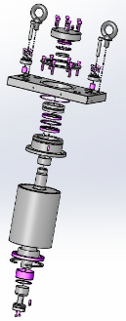
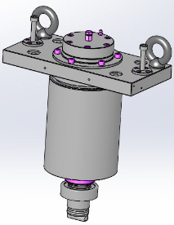
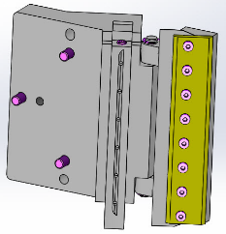
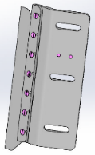
Secure the right glue quantity on each label
New Glue Roller – pack “a”
VALUE AND BENEFITS
DESCRIPTION
Secure production by replacing obsolete components (chromium rollers not manufactured any more) with latest technology glue roller
Prevent glue splashing and filaments guaranteed by “niches” shape;
Secure the proper quantity of glue applied on the label;
Better control of quantity of glue applied: if more glue is needed it is enough to increase the niches’ volume and the label pads’ area;
Reduce maintenance costs and machine downtime:
recommended roller replacement jump from 9000 h with actual version to 36000h with new version
Scrapper Life time doubled
Reduced cost of replacement parts ( on average -15%)
Being the existing glue roller technology obsolete, Sidel provides an new assembly to deliver the right glue quantity on label:
Auto-adjustable glue bar with an integrated scraper system
New concept of glue transfer with controlled temperature
Niches created with a laser cutting
The pack contains the necessary unassembled parts for the installation of the new glue roller.
Value: Efficiency, Maintenance, Obsolescence
Equipment: Labellers F15 Evo, Rollquattro, Rollquattro Evo, Matrix, Sidel Super Combi, EvoDECO
Catalogue code: AA27a

