Slide 1
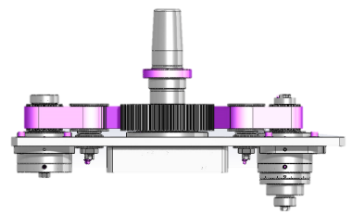
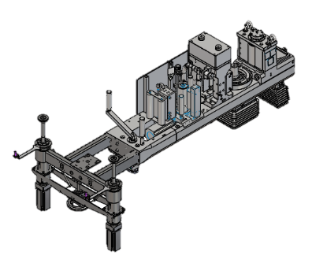
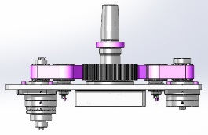
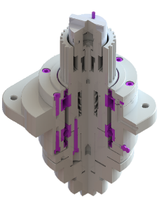
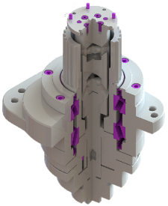
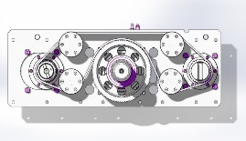
Reduce maintenance cost
Cutting Unit new joint
VALUE AND BENEFITS
DESCRIPTION
Component not subject to wear thus, for maintenance, only controls (for greasing) to do;
Reduction of the maintenance time and cost;
Maintenance procedures simplified;
Reduction of machine downtime;
More efficiency (more durable component and it allows a more precise control).
The Oldham joint in the cutting unit allows the motion, through the transmission belt, of the cutting roller and at the same time allows the cutting timing according to the label format.
With this upgrade the Oldham joint is replaced by the Cardan joint: this new component is not subjected to wear, thus allows less maintenance time and cost (it eliminates totally the ordinary maintenance) and less machine downtime. This new joint guarantees to have a more precise and controlled motion, to the full advantage of the labelling quality.
Current solution: Oldham joint
New solution: Cardan joint
Labelling station
Oldham Joint to be replaced
Cutting module
Value: Maintenance
Equipment: Labellers Rollquattro Evolution F25E and F35E
Catalogue code: AA28

