Slide 1
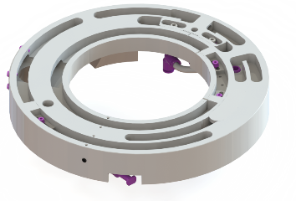
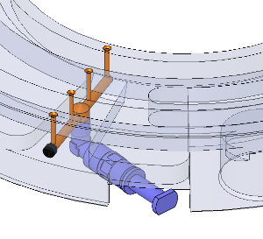
Reduce your maintenance cost
Vacuum Distribution Plate Automatic Lubrication
VALUE AND BENEFITS
DESCRIPTION
  Reduced frequency and greater simplicity
  of routine maintenance
  Reduction of the maintenance time and cost
  Reduction of machine downtime, so more production time available
The new system consists of a grease feed pump for the lubrication, located between the vacuum distribution plate and the vacuum drum.
Using a sensor, this system detects the number of cycles and, as required, delivers a defined amount of grease
Value: Maintenance, efficiency
Equipment: Labelers Rollquattro, Rollquattro Evo, Matrix
Catalogue code: AA29

