Slide 1



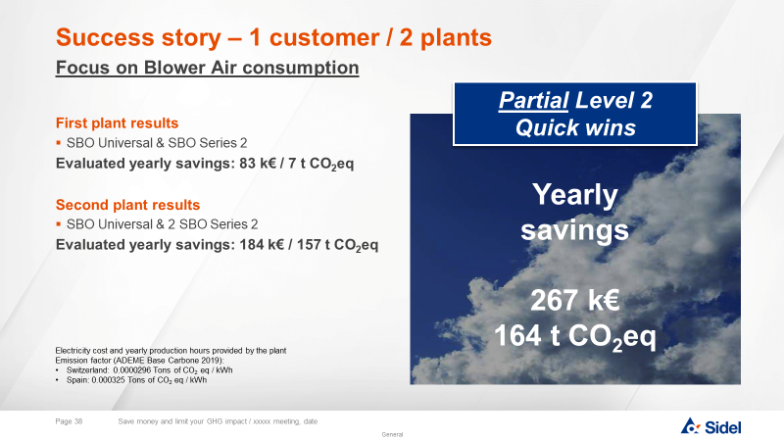

Eco-Audit Services – BLOWER
Sustainability
AU05-1 Eco-Assessment
KEY FIGURES
Budget price
BENEFITS
DESCRITPION
Already some success stories
RSP | 15 000 €
PURE AUDIT including
INSPECTION machine wearing, production quality
MEASUREMENT energy consumption per identified SKU, potential leakages
ANALYSIS
and REPORTING with all IMPROVEMENTS POSSIBILITIES
On-site measurements to check bottle production performance and power consumption
Packaging assessment to identify optimization areas
Measurement analysis to identify optimisation levers
Equipment inspection to check overconsumption due to wear parts or non-optimized settings
Comparisons with original equipment specifications and ‘’Best in class’’ values from our databases
Payback estimation
Not Applicable
Installation time
Not applicable
Machine downtime
Lower operating cost for lower environmental footprint
Audit duration = 3 days incl. 1 full day production stoppage
DELIVERABLES
Can be combined with:
Corrective action plan including Packaging with clear priorities for optimising equipment consumption levels associated to their payback
Diagnostic Visit
Packaging Process Intervention
Machine application:
SBO Series 2
SBO Universal
SBO Matrix

